Slide 1
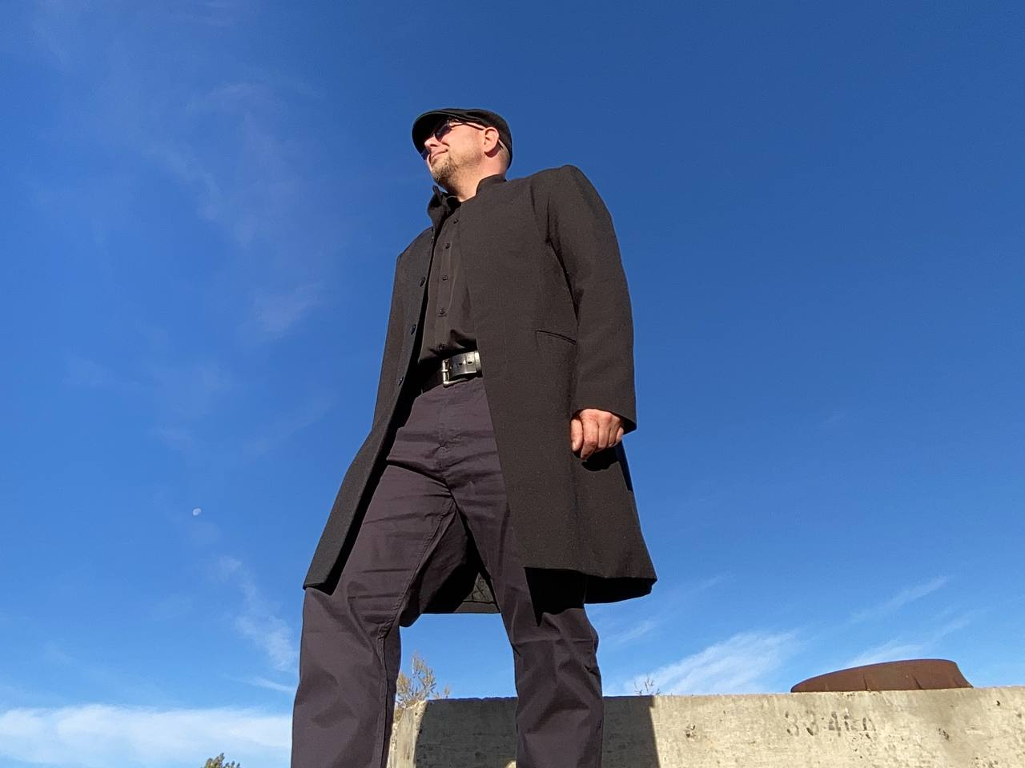


Ryan Orydzuk:
Health and Safety Professional & Subject Matter Expert
I am an exiled federal safety officer with close to a decade of experience and education as a safety professional within the federal government.
I have attained my bachelor of arts degree from the University of Concordia in Edmonton, Alberta, and have been educated in the following aspects in relation to my position as Health and Safety Officer and Human Resources Business Partner at Canada Post: Compliance, Emergency Management, Risk Assessments, Emergency Response, Unknown Substances/Hazardous Products, WHMIS, Joint Health and Safety Committees, Work Refusals, Mental Health, Industrial Hygiene, Mediation and Harassment/Violence in the Workplace.
I functioned as a “Jack of all Trades” at Canada Post and was the frontline resource for clients within Northern Alberta, Northeastern BC and the Northwest Territories.
My clients consisted of: 1300 frontline employees, 1 regional Director, 4 Area Managers, 25-30 area Superintendents and Supervisors, 11 Local Joint and Health and Safety Committees. My primary function was as a subject matter expert in safety, but I also had responsibilities in Human Resources and Labour Relations
In 2015, our safety team was responsible for the lowest recorded injury rates at Canada Post and were recognized nationally for our successes. I also successfully lowered the injury rates within my area of responsibility at Canada Post consistently over the last decade.
I am currently in the process of working towards my Health and Safety Advisor certification with the Alberta Construction Association.
The Covid-19 management processes and vaccination mandate completely destroyed my life, and I am still suffering the fallout of the employer’s actions.
Link to banned podcast and to my book Disgruntled below:
Posties for Freedom
Contact Email:
Lobowithsafety@hotmail.com
Community Contact:
Postiesforfreedom.ca
“Injustice anywhere is a threat to justice everywhere.” Dr. Martin Luther King jr.

