Slide 1
National Citizens Inquiry: The Pillars of Outbreak Response
Jeff Wilson DVM, DVSc, PhD
President, Novometrix Research Inc
May, 2023

Slide 2
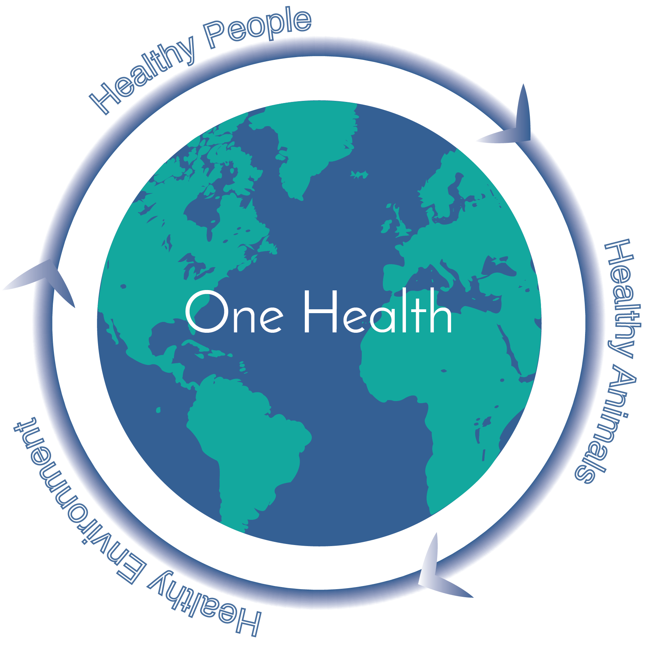
About Novometrix Research Inc.
We align networks for solutions to
complex problems
Jeff Wilson (President)
DVM, DVSc, PhD (Epidemiology)
Professor, U of G Cross-appointed to PHAC, 18 years
PHAC epidemiology lead including Walkerton Water Crisis
Notes:
The collaborative economy has been called the third industrial revolution - and it’s believed by many that its impact will eclipse that of the industrial revolution
We’re all familiar with the disruptive impact of companies like Uber and Air B and B; well, that level of transformation is about to spread through the entire global economy
Unlike Uber, though, the next waves for collaborative enterprises won't be owned by individual corporate entities - they'll be run by all of us, collaboratively

Slide 3
Outbreak response:
Moving from critical evaluation to coherent solutions
Critical evaluation of outbreak response is key - but then what?
Creating recommendations is helpful but:
How do you ensure they get implemented?
And what happens when things change for the next outbreak?
New Bug
New Drug
New form of government, business, academic or social dysfunction

Slide 4
Hint: Ask, how more generally, do we solve problems that are new to us?
Answer - Begin by modelling success:
Find a person or group who have already successfully managed the type of problem facing you
Don’t start by trying to invent an approach yourself if this is not a problem you are familiar with
Don’t start by listening to those who haven’t actually solved this kind of problem before - no matter how much they claim they have
Use your powers of discernment regarding expertise, motives of others

Slide 5
Example: if your house is haunted, who should you call?
Your father in law?
Your doctor?
Your member of parliament?
The Globe and Mail?
Ghostbusters
The ultimate problem solving technique.
Ask ‘Who has already done this, and what’s their phone number?’
Call them

Slide 6
The Pillars of Outbreak Response
Fortunately, a process to manage outbreaks already exists. It is:
Proven in thousands of outbreaks globally
Highly repeatable
Highly teachable
Cross-cultural
It was also almost entirely ignored during the Covid-19 pandemic
We call this process The Pillars of Outbreak Response

Slide 7
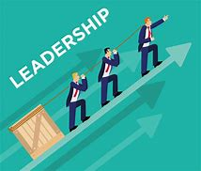
The Pillars of Outbreak Response
Leadership teams
Tests, literature and data framework, analysis
Treatment and prevention
Communications
Notes:
Highlight transparency / transparent……. That would resonated with me the lack of it

Slide 8
The Pillars of Outbreak Response
The approach is not prescriptive
It is a coherent leadership and management framework which:
Uses proven principles
To iteratively achieve results for new problems and situations
What does this actually mean? Let’s look at an example of a well managed
outbreak response…

Slide 9
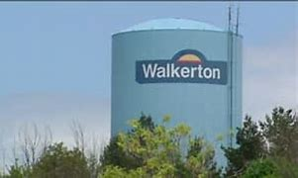
The Walkerton Waterborne Disease Outbreak
2000, Town of Walkerton, Ontario, population approx 5,000
Source was municipal well contaminated with E. coli O157, Campylobacter etc
2,300 cases, 7 deaths
Highly publicized nationally and globally

Slide 10
PIllar 1: Build effective leadership team(s)
Transparent
Inclusive
All key expertise and perspectives around the table
Focus on solving the outbreak - not career, personal gain etc

Slide 11
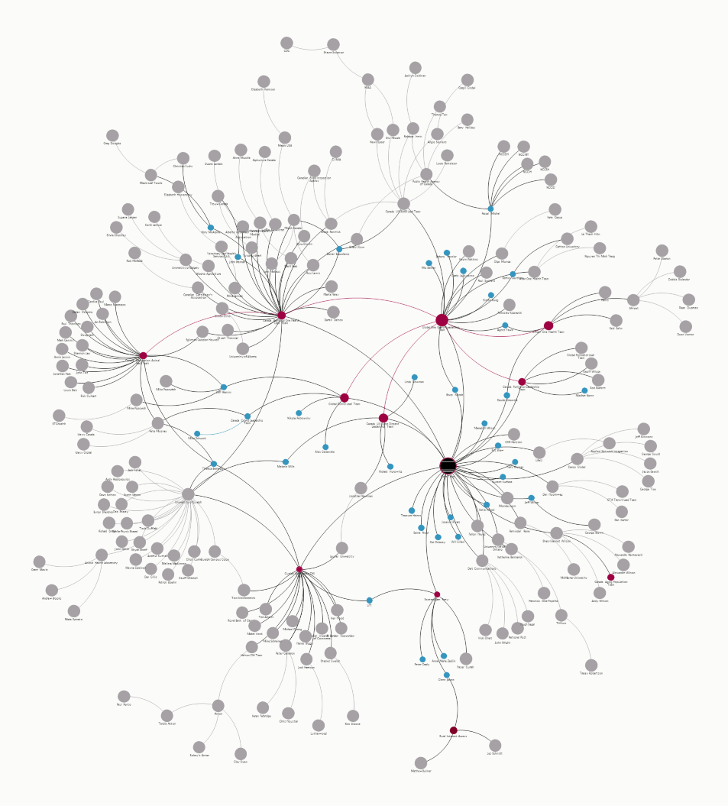
PIllar 1: Walkerton team(s)
Local PH
Local physicians, pharmacies etc
Local government departments
PHAC
Ontario PH
Neighbouring health units
OMAFRA
Multiple academics
RCMP
Local politicians
Media
Multiple others

Slide 12
Pillar 2: Tests, Evidence, Data & Analyses
to Drive Effective Action
Use validated tests (infection, disease, determinants of health)
Content experts, broad representation
Build shared literature repository & discuss
Collect data on outcomes and risk factors
Statistical analysis to identify high risk groups and effective interventions

Slide 13
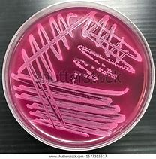
PIllar 2: Tests
Test used was the GOLD STANDARD: identification of the etiologic agent (E. coli O157:H7)
PCR was available - but is difficult to interpret, sensitivity and specificity unclear
Sick with E. coli distinguishable from sick from E. coli
We know how many are affected, who they are and how to
Prioritize interventions

Slide 14
PIllar 2: Literature and Expert Input
Relevant literature was continually gathered and shared among team members
Content experts - at all levels - were engaged for input
Ongoing integration of new evidence to modify outbreak response
Iterative and flexible: NOT Prescriptive

Slide 15
Pillar 2: Collect the Right Data Through Surveillance
Outcomes
Infection
Disease
Mortality
Mental health
Social & Economic
Risk factors
Food, water, environment
Age, sex, location, time
Put the data in a database and share transparently
This is called a TRANSPARENT DATA FRAMEWORK - It is CRITICAL

Slide 16
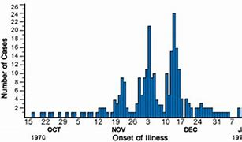
PIllar 2: Analyze the Data Properly
Epidemic curve
Attack rate tables
Logistic regression for source well
I

Slide 17
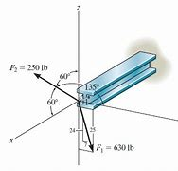
Spreadsheet modelling
Note that Spreadsheet Modeling was not used as it is of almost no value in this context and can be very deceptive
Why? We simply don’t have effective models for this kind of situation
Some situations where spreadsheet models can be effective:
Hypothesis generation
Situations where the models and required data exist
and can be validated empirically

Slide 18
‘Misinformation’ during the Walkerton outbreak
Well managers misled Public Health about problems with Well 5
Drilled in a swamp
Positive tests for bacteria
This was identified and rectified, including legal action
Lesson: With good leadership, ‘misinformation’ can be managed

Slide 19
Pillar 3: Interventions
Are based on transparent discussion of PIllar 2
Literature
Expert opinion
Empirical data
Under guidance of Pillar 1
Inclusive, transparent, collaborative leadership team
Not Through Decision-Based Evidence making
i.e. assembling evidence to support a policy decision

Slide 20
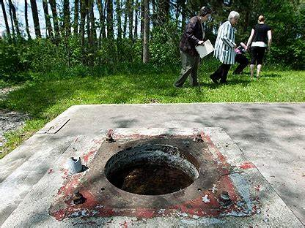
PIllar 3: Interventions
Find the source
Boil water advisory
Find sick people and treat them
Find the offending well
Shut it down
Lessons learned and provincial small water systems
evaluation and remediation

Slide 21
PIllar 4: Communications
What:
Complete
Correct
Transparent
Multi-directional
With all required parties, stakeholders, public
By whom?
Government
Business
Academia
NGOs
Media
Public

Slide 22
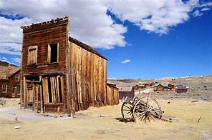
Might Walkerton have Descended into Chaos?
Definitely
What might it have looked like
Source not identified?
Continued water consumption?
Mortality and illness ongoing for another 23 years?
Trying to control with an E. coli vaccine?
Mass exodus from Walkerton, lawsuits etc etc?
Similar outbreaks in other communities unmanaged?
Why didn’t this happen?
SIMPLE: LEADERSHIP, through The PILLARS

Slide 23
What About the Covid Outbreak Response?
Pillar 1: Coherent leadership teams at any level?
Pillar 2: Tests? Literature? Expert input? Data framework? Analyses?
Pillar 3: Prevention and treatments based on 1 and 2?
Pillar 4: Communication? Clear, complete, correct, transparent, multidirectional to all stakeholders?

Slide 24
The details matter!
It doesn't count to point to
Some meetings that occurred
Or some data that were collected
Or some interventions that were tried
Or some communications that happened
The Pillars only work when they are done correctly!
We must avoid self delusion and rhetorical devices
to deflect accountability. This is another component
of leadership (Pillar 1)

Slide 25
Who is responsible for failures in the national Covid outbreak response?
All of us
Govt
Academica
Business
NGOs
Media
Public at large

Slide 26
How is the Covid outbreak Different from Walkerton?
Different bug, different transmission, different interventions
But that’s true of all outbreaks - they are all different
But they are also simply variations on the same theme
And they are all amenable to the Pillars of Outbreak Response
Most of all, the Covid outbreak is different because…

Slide 27
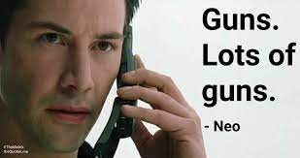
It’s BIG. Very Big
Being BIG magnifies all the things that can make a any outbreak go off the rails:
Politics
Careerism
Money
Fear
Ego
The solution is always the Pillars of Outbreak Response

Slide 28
For a BIG outbreak, we need to Scale the Pillars
We need Leadership, Coordination & Effectiveness at a BIG scale
Enter Community Network Integration (CNI)

Slide 29
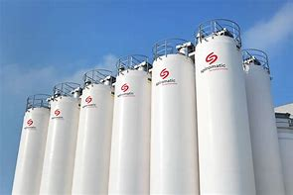
Integrated Networks
Conventional Networks
Siloed
Fragmented leadership
Self interested
Suspicion
Positioning, rhetoric
Secretive
Duplication
Compete for same funding
Limited results
Connected
Leadership of the whole
Common vision
Trust
Authentic
Transparent
Eliminate redundancy
Grow the pie
Limitless results
Notes:
We’re all aware of the idea of stakeholder networks and many of us have been involved in network activities - for example being on a steering committee or participating in public discussions around a community issue. Even voting can be viewed as a form of network interaction.
Here’s a critical distinction though. Although network activities are common - truly integrated networks that focus on aligning stakeholders effectively - in a way that everyone optimizes their outcomes - are exceedingly rare. The collaborative economy is emerging at this point in human history precisely because it holds the promise of everyone benefiting, and participating in its management and leadership.
This chart shows some of the differences between conventional networks and integrated ones.
Primary among these is that conventional networks are siloed - they have some connectivity between some stakeholder groups but it's usually not complete - this often results in groups with a similar worldview aligning with each other - and opposing those they differ with. Integrated networks, by contrast are connected throughout
The primary reason for this siloing in conventional networks is fragmented leadership - there is no leadership of the whole which exists in integrated networks
This lack of cohesive leadership of the whole results in a range of outcomes that hurt virtually everyone in the network. For example, limited self interest of players results in a failure to understand and appreciate others in the network. This leads to suspicion, positioning and secrecy as opposed to listening to others. This can cause duplication of effort and competing for the same resources. The result is often results that are disappointing.
In contrast, in integrated networks, collaborative leadership of the whole leads to a common vision where everybody wins. The focus is on creating a culture of trust, authenticity and transparency. And as a result it's possible to identify and eliminate redundancies in the network (like time and money washing activities) and focus on growing the pie for everyone. The result is limitless scalability of value creation.
Incidentally, CNI does not seek to replace existing network collaborations - it simply assists in connecting and optimizing them

Slide 30
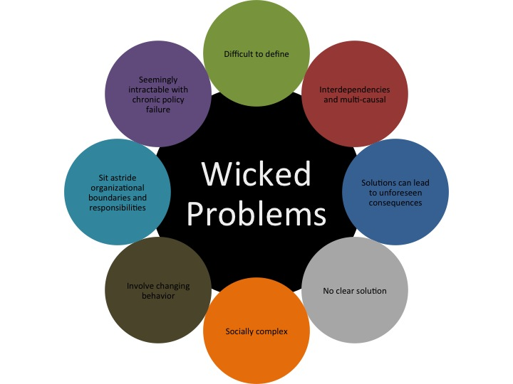
Community Network Integration (CNI)
A systematic process to align stakeholders to create solutions that are otherwise impossible (‘Wicked Problems’)
By collectively innovating projects that advance the fundamental interests of each party and change behaviour
Notes:
Community Network Integration simply takes existing networks - and transforms them so they work way better for everyone
Like this slide says, it is a systematic process to align stakeholders to create solutions that are impossible otherwise - solutions to things like creating economic prosperity, better health and environmental sustainability
By aligning stakeholders - that is, by having them come together in a state of cooperation - its possible to then collective action - usually in the form of scalable pilot projects - that advance everyone’s interests
Having aligned our stakeholders it’s possible to then create a platform - an ongoing process of alignment to create solutions to many issues over time
And finally, all of this is done under a third party governance structure - no one organization or person owns or runs the process - together we run it collaboratively through participatory decision making
Understanding how this works is usually happens bit by bit - like peeling an onion. And it depends on your personality and life experience: you may understand this immediately - or it may take some time.In this presentation we’ll be explaining more and giving some examples - and there will be lots more information to come. At the end of the day, hough, you’ll find that the best way to understand it is by becoming involved in the process.

Slide 31
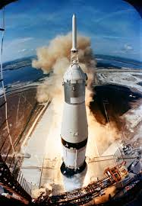
Why CNI is different:
CNI adds what is almost always lacking: a coherent business process FOR THE WHOLE NETWORK including optimal
Vision
Leadership
Culture of high emotional energy (hi E)
Governance structure
Human Resources, network engagement
Projects, products, services
Resource acquisition, marketing
Administrative, Communications, Financial, IT and other systems
Notes:
This leads to the first breakthrough offered by CNI
It adds what is missing in virtually every conventional network - a coherent business process for the whole network - so together we can actually lead and manage our collective activities.
If you doubt the value of that, think about any issue in the world that you think is important and ask yourself - is anyone actually in charge of leading this - bringing the required stakeholders together and helping them to craft cleaver solutions. I guarantee you, they aren’t.
Look at the list of elements in this slide and you’ll see that they are the same things you see in effective management of what we call enterprises - things like companies, organizations, universities and so on. CNI simply adds these things that work so well in enterprises to stakeholder networks.
There’s one big difference though. Whereas enterprises are run as hierarchies - with someone in charge at the top and everyone reporting back to them, stakeholder networks are distributed. There is no hierarchy and no way to force people to do what you want. Insead, they are co-led through a process of participatory decision making

Slide 32
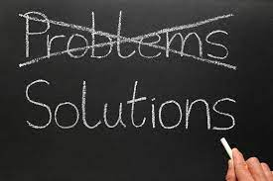
For Walkerton CNI was done Intuitively
For Covid, and other wicked problems we face,
we must now learn to do it consciously
Climate change
Inflation
War in Ukraine
Future pandemics
It’s Time for Coherent Solutions

Slide 33
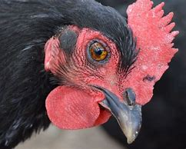
Examples of CNI now in progress
Avian Influenza (AI)
Another national / global outbreak series
Potential to be the next pandemic
Involves many of the same players
Opportunity to create what was missed during Covid (ie The Pillars at a national level!)

Slide 34
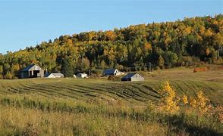
National Poultry Network
Leadership team
Producers (large & small)
The Public
Virologists, pathologists, epidemiologists
Federal and provincial governments
Pharma and biologics
Associations
Public health
American counterparts now engaged
Running the PIllars under collaborative quality management, nationally

Slide 35
The Pillars of Outbreak Response
Leadership teams
Tests, literature and data framework, analysis
Treatment and prevention
Communications
Notes:
Highlight transparency / transparent……. That would resonated with me the lack of it

Slide 36
Other intersecting CNI networks now in progress nationally
Guelph Wellington project
National Collaborative networks (NCN)
Global Pollinator Sustainability network (GPSN)
Pet Nation
National pharmaceuticals and Biologics Network
National Public Health Network

Slide 37
Let’s work together to scale this across all networks in Canada!
To do this we will need to focus on building what we want
Not attacking what we don't want

Slide 38
For more information…
www.novometrixinc.com
Canadian Collaboration Project – Novometrix Research Inc (novometrix-ccc.com)
(639) Community Network Integration - YouTube

