Slide 1
Covid Lockdown Mistakes
We Should Never Forget
Dr. Douglas Allen
Burnaby Mountain Professor of Economics
Simon Fraser University
May 4th, 2023

Slide 2
What Authority Does an Economist Have Regarding Covid19 Lockdown?
Trained in
- the use of mathematical models.
- econometrics and statistics
- cost/benefit analysis
Published 3 articles on Covid Lockdown.
- one has been downloaded over 60,000 times and was ranked #32 in the top
articles discussed on Twitter in 2021.

Slide 3
Mistake #1: TOTAL Costs and Benefits were miscalculated or not included
- Breifly discuss “SIR” models and why they over-estimated deaths.
- Focus on the exogenous behavior assumption.
- Show a problem in value of life calculations.
- Examine the actual number of lives saved by lockdown.
- Problems with cost calculations.
- Focus on “collateral deaths” caused by lockdowns.
- Mention Cost/Benefit Problems with vaccine mandates.

Slide 4
Simple SIR models failed to predict Covid19 deaths
- SIR models are just a set of simple differential equations.
- Predict the change in the number of people who are Susceptible (S), Infected (I), and
Recovered (R) over time.
- Like all models, the predictions depend on the STRUCTURE and PARAMETERS.
These models were used to measure the BENEFITS of lockdown.

Slide 5
SIRS models (susceptible, infected, recovered).
Assumptions.
100% susceptible
Rt =2.4
IFR =0.9%
Zhombies.

Slide 6
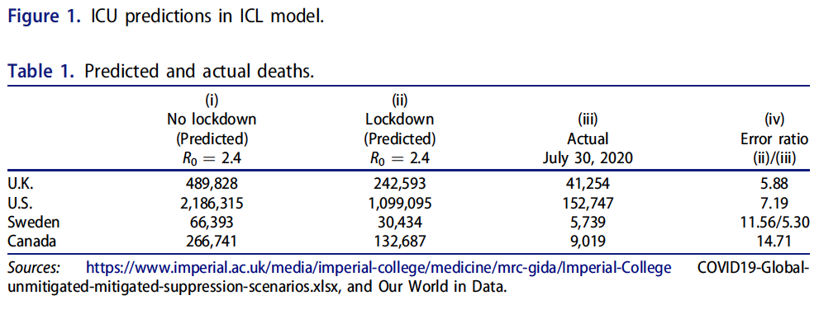
RESULT: These Models Failed Miserably.
April 21, 2023: 52,121.

Slide 7
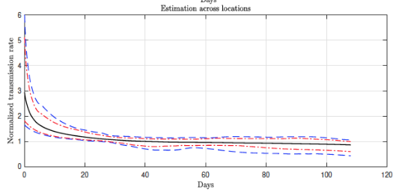
Fatal Error: The Exogenous Behavior Assumption
- Unlike the model assumptions, we are not rocks or zhombies.
We reached an Endemic State almost immediately.
Every place had the same
outcome, regardless of
lockdown
Atkenson et al. August 2020 (UCLA)

Slide 8
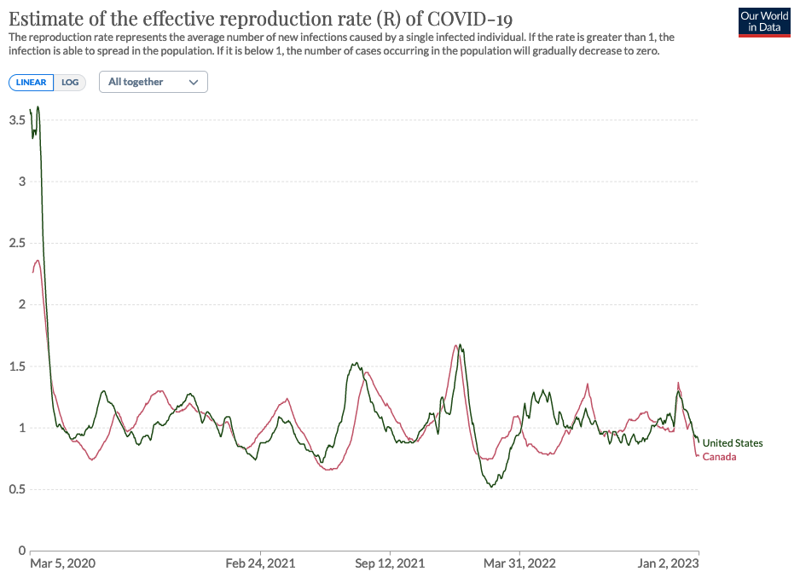
Behavioral Endemic
State
Biological Endemic
State

Slide 9
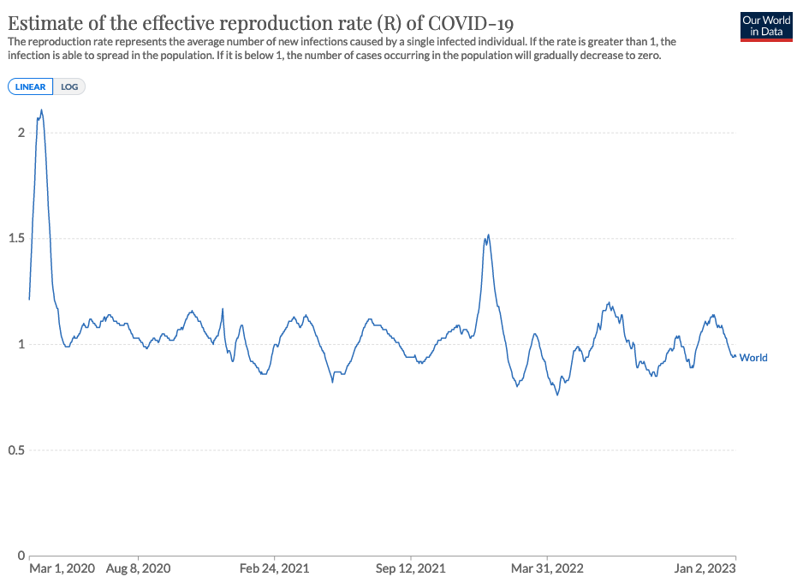

Slide 10
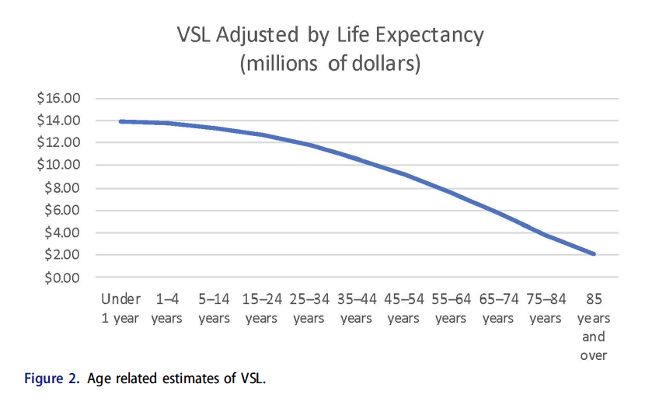
Mistake #2: Value of Lives Saved was Mismeasured
Economists and other use a concept called the “Value of Statistical Life”
It looks at the trade offs people
make that reveal the value
they place on their life.
It is a measure of the “utility”
of living.
Child: $14 million.
85 year old $2 million.

Slide 11
Most of the 2020 studies assumed VSL =$10M for everyone
- Not just wrong, but absurd. Means you’re indifferent between living one more day or 40 years.
- Grossly over estimates the benefit of lockdown because average age at death was over 80.
No Lockdown: 266,741 deaths
Full Lockdown: 132,687 deaths
Lives Saved: 134,055
134,055 x $10M = 1.34 Trillion!
- About ½ of Canada’s annual GDP.

Slide 12
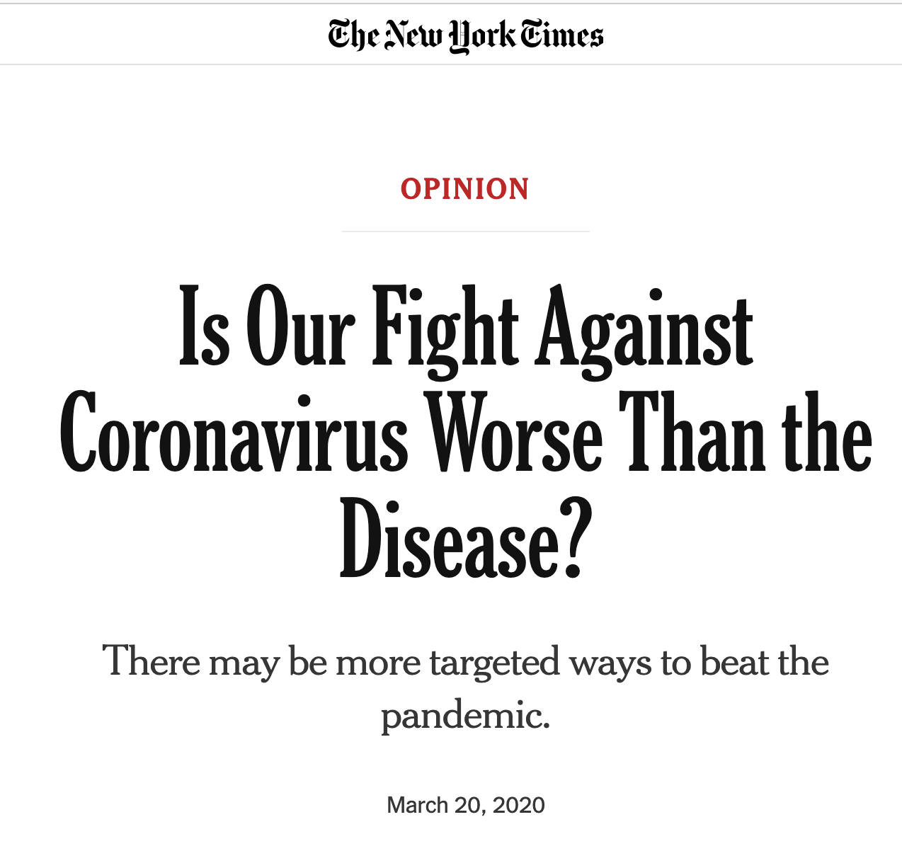
Mistake #3: Don’t Ignore the Data
- Empirical work on the effect of lockdowns on deaths was immediate.
Dr. David Katz, epidemiologist.
Data from: S. Korea, UK, Netherlands,
US, and Diamond Princess.
Identified all key Covid Characteristics.
A pivot right now from trying to protect all people to focusing on the most vulnerable remains entirely plausible. With each passing day, however, it becomes more difficult. The path we are on may well lead to uncontained viral contagion and monumental collateral damage to our society and economy. A more surgical approach is what we need.

Slide 13
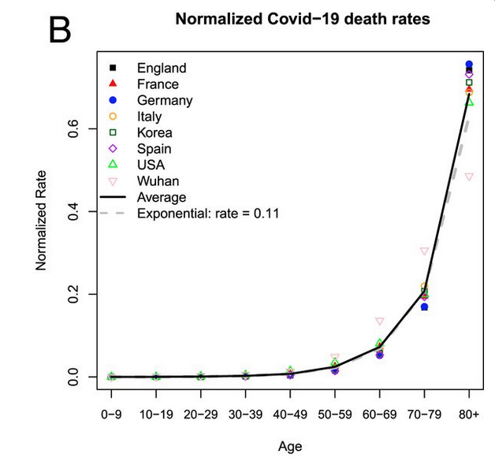
Nine days after the Pandemic was declared we had information that:
IFR was function of Age.
-Average IFR was NOT 0.9%
By end of spring 2020 estimates were
IFR = 0.15%
99.85% survive.
We knew quickly we were not dealing
with the Grim Reaper.

Slide 14
My 2021 study
“A reasonable conclusion to draw from the sum of lockdown findings on mortality is
that a small reduction (benefit) cannot be ruled out for early and light levels of lockdown
restrictions. There is almost no consistent evidence that strong levels of lockdown have a
beneficial effect, and given the large levels of statistical noise in most studies, a zero
(or even negative) effect cannot be ruled out. Maybe lockdowns have a marginal effect,
but maybe they do not; a reasonable range of the decline in Covid-19 mortality is 0–20%.”
April 2021

Slide 15
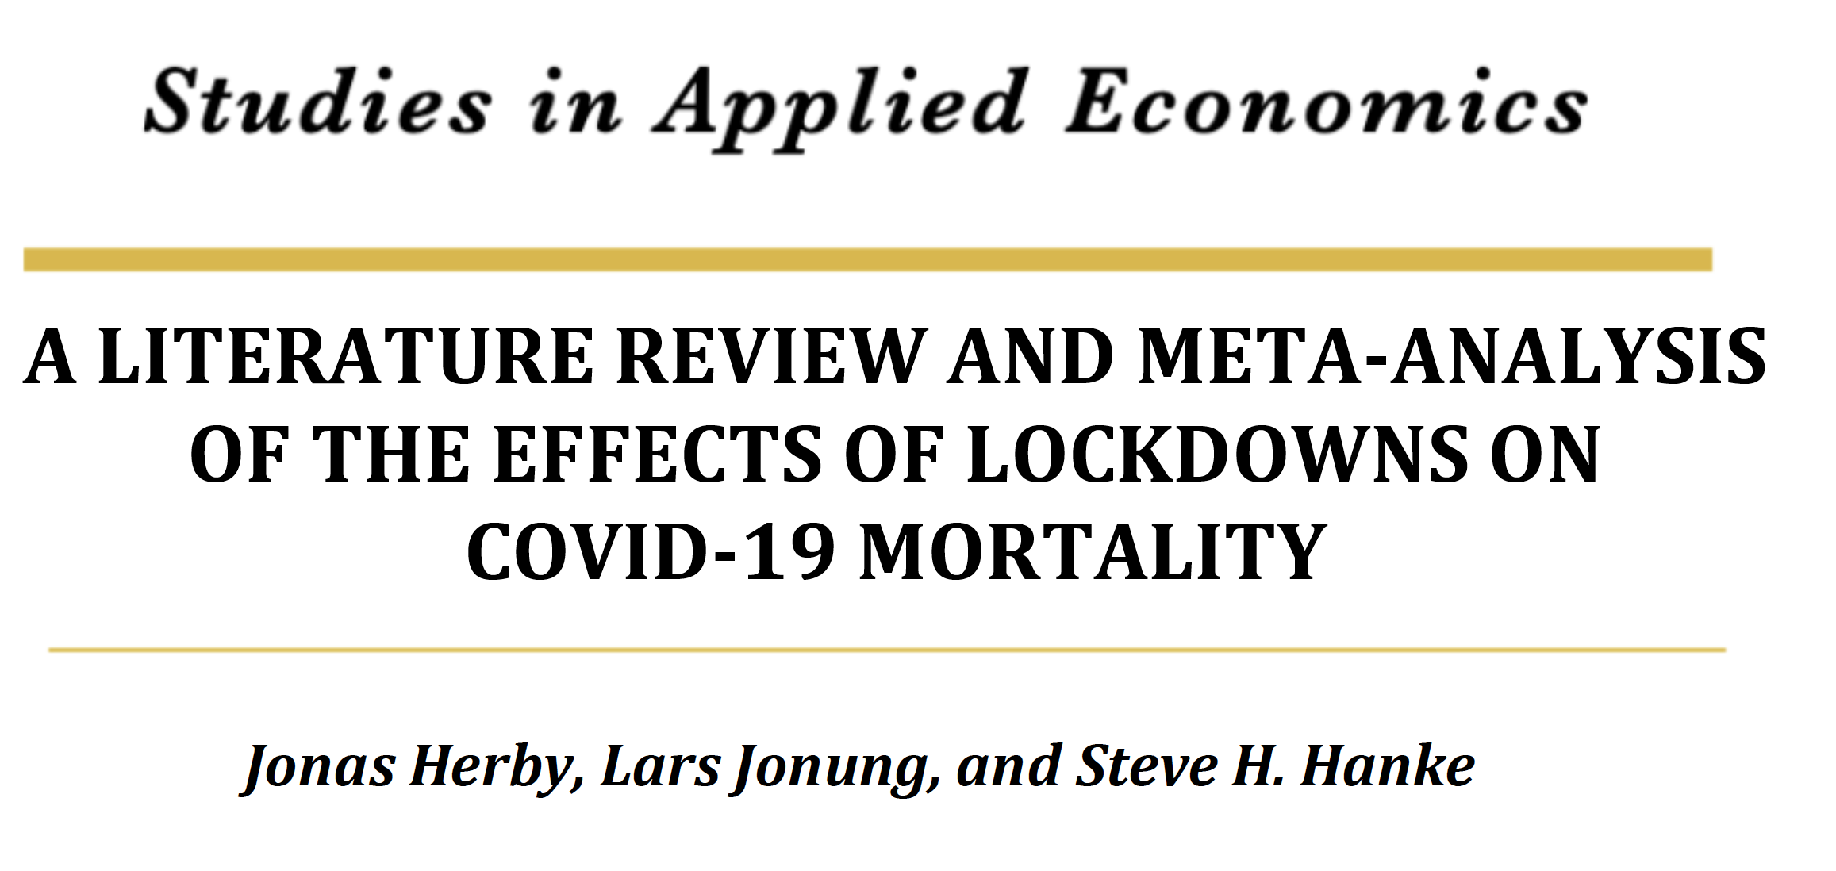
January 2022
- Screened over 18,000 studies.
- Meta analysis of all “Difference-in-Difference” Studies.
- Conclusion: Only 3.2% reduction in mortality.
“An analysis of each of these three groups support the conclusion that lockdowns have
had little to no effect on COVID-19 mortality.”

Slide 16
So, On the Benefit of Lockdown Side …
We knew very early on the models were wrong.
We had empirical evidence in the summer of 2020 they were ineffective.
By Spring 2021 we had many empirical studies showing no effect.
By Fall 2021 a massive meta analysis confirmed lockdown (NPIs) had
almost no effect on mortality.
There was NO BENEFIT to locking the population down.

Slide 17
Mistake #4: Mismeasure of The Costs of Lockdown
- Initially the ONLY cost considered was lost GDP.
- Created an “Apples vs. Oranges” comparison.
Benefits were measured in “lost utility” ($1.34 Trillion), but costs measured in lost
output.
- What if we measured the lost GDP of an 80 year old dying?
My 2021 Study:
- convert lockdown costs to lost utility. Cost/Benefit Ratio: 141!
- For every eighty year old death averted by lockdown, we killed the equivalent of 141
eighty year olds!

Slide 18
Additional Costs Include:
- Lost education, and consequences
- Increased deaths and reduced life expectancy due to increased unemployment
- Increased deaths of despair
- Increased domestic violence, family breakdown
- Supply chain disruption costs and consequences.
- Direct Deaths caused by lockdown. “Collateral deaths”
We have only begun to measure these, and it could take a generation.

Slide 19
Collateral Deaths:
“Summing our estimates across causes and age groups, we estimate 171,000 excess
non-Covid deaths through the end of 2021... For the European Union as a whole, the
estimate is near-identical at 64 non-Covid excess deaths per 100K. In contrast, the
estimate for Sweden is -33, meaning that non-Covid causes of death were somewhat
low during the pandemic. We suspect that some of the international differences are
due to the standard used to designate a death as Covid, but perhaps also Sweden’s
result is related to minimizing the disruption of its citizens’ normal lifestyles.”
Mulligan and Arnott (2022)
US had 825,929 Covid deaths by Dec. 2021.
If lockdown reduces deaths by 3.2%, then 27,303 lives were saved.
Cost/Benefit ratio: 171,000/27,303 = 6.3.

Slide 20
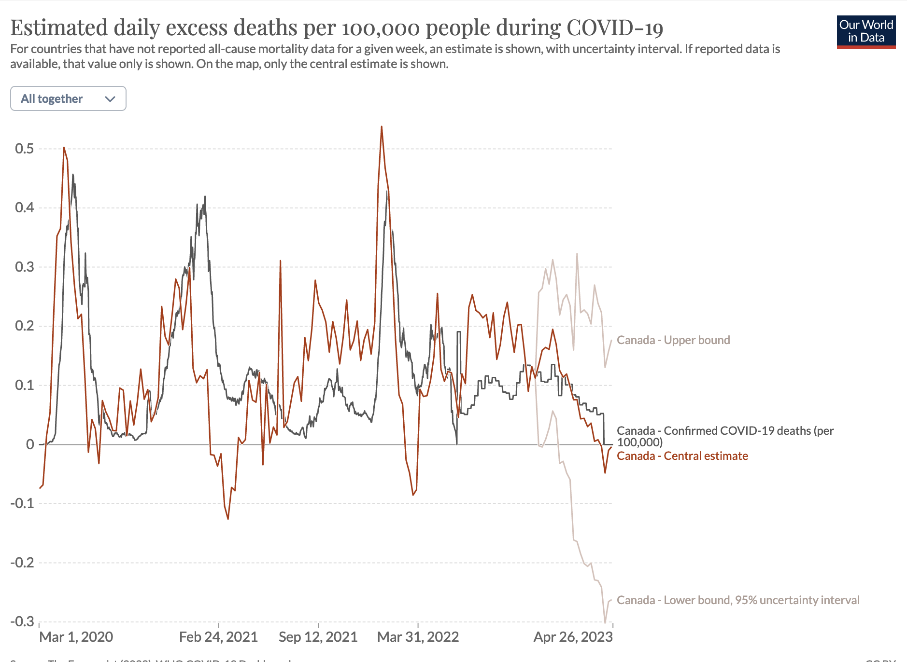
Since the Spring of 2021
Canada has had what
looks like collateral deaths.

Slide 21
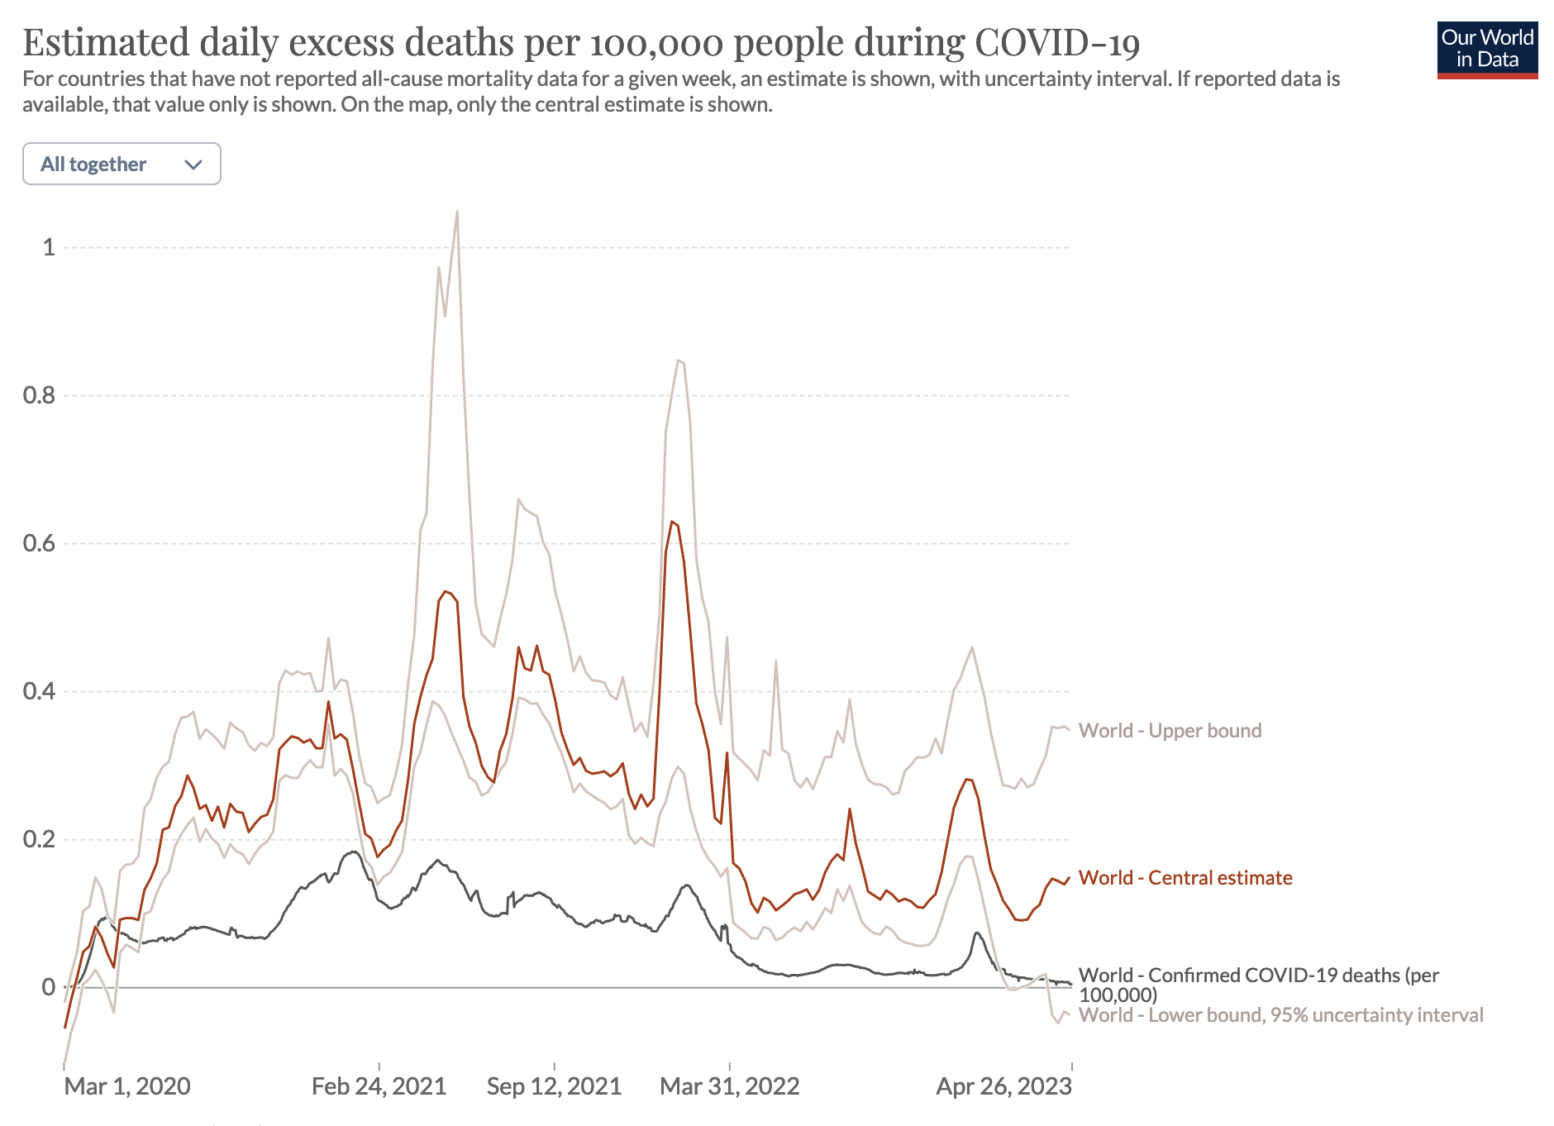
Speculative, but it looks like
we have caused massive
excess deaths across the
world.

Slide 22
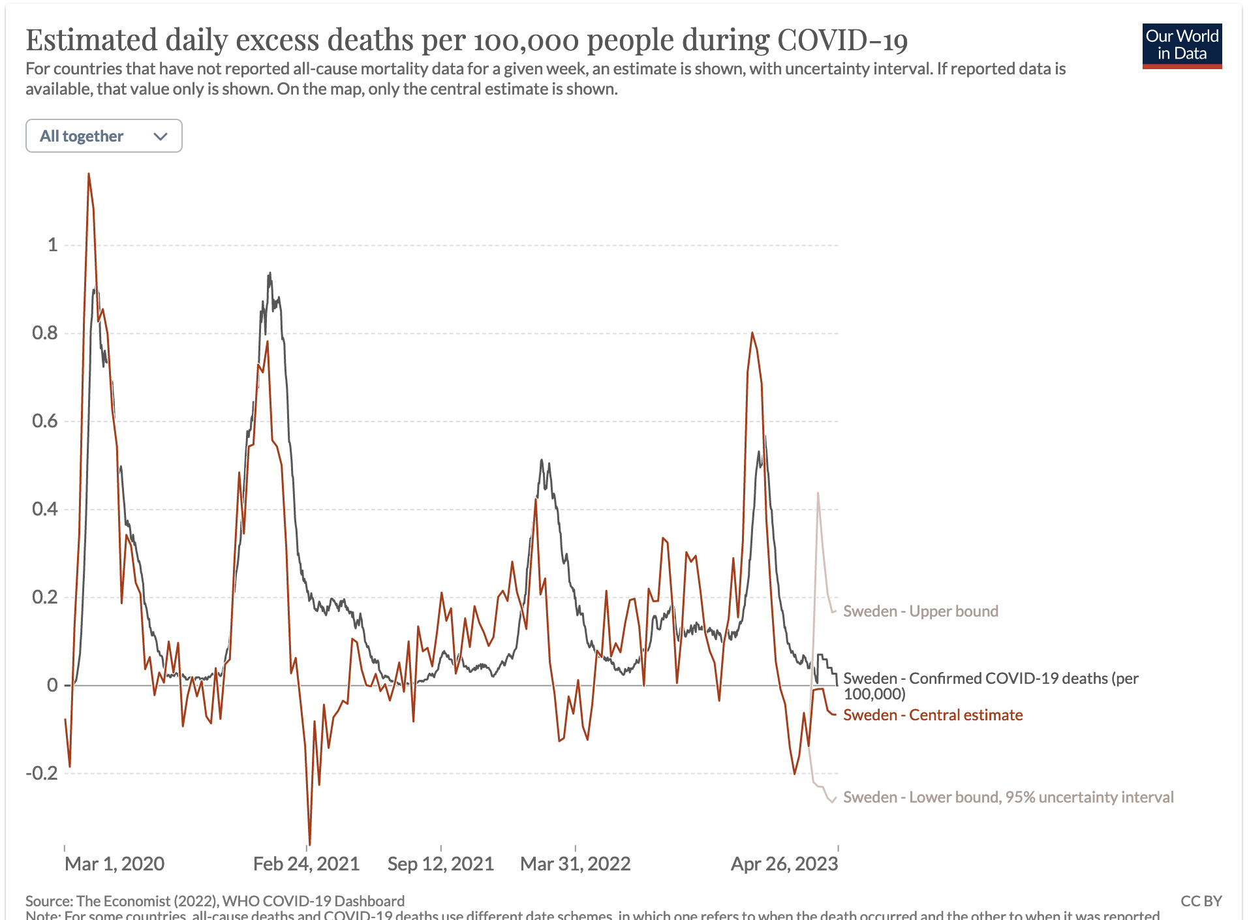
No evidence of large
collateral deaths in
Sweden.

Slide 23
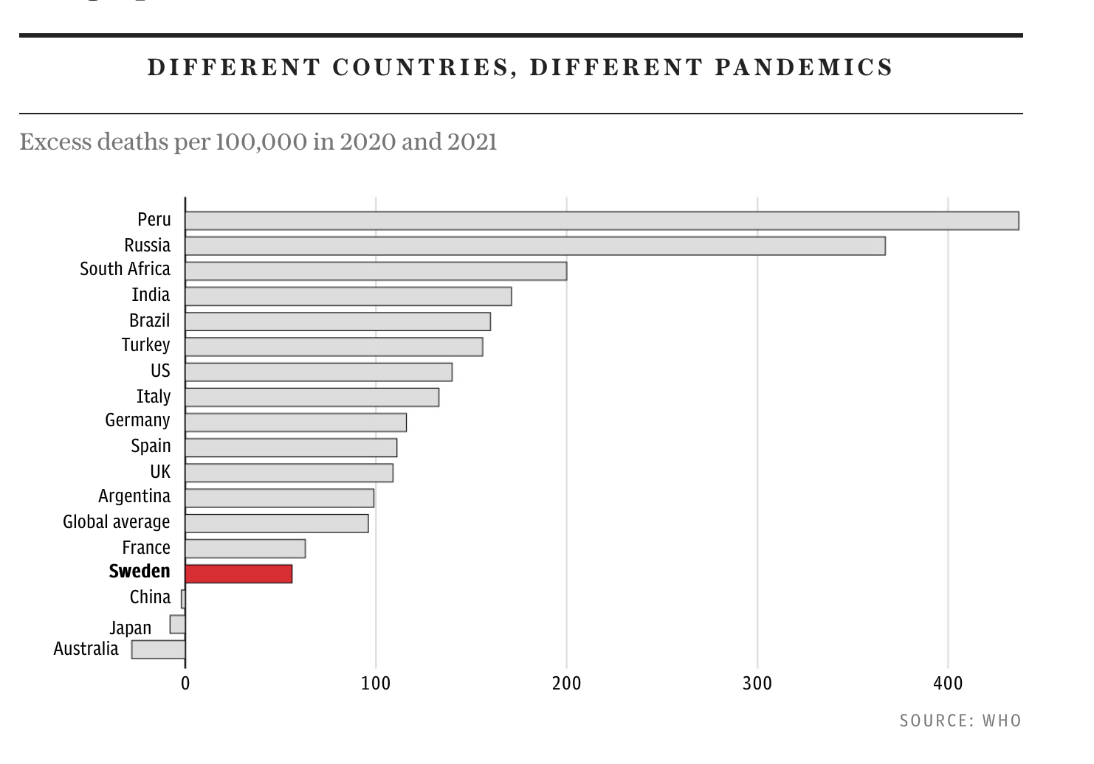

Slide 24
Bottom Line: Cost / Benefit practically infinite.
Lockdowns are not just an inefficient policy, they must rank as one of the
greatest peacetime policy disasters of all time.
Allen 2021

Slide 25
Other Mistakes
Mistake #5: Vaccine Mandates.
A Coronavirus cannot be isolated, like smallpox, because it lives in animals and people.
- A Coronavirus always mutates, and unlike measles, no single vaccine can protect you.
- Many were “non-responders” to the vaccines.
- Therefore, the vaccines always had “leakage”.
- These facts create problems for vaccine mandates.

Slide 26
Vaccines Mandates, Problem 1.
Purpose is to assure the vaccinated that others are not unvaccinated.
- But the vaccinated get infected … and we didn’t know the different infection rates.
- Conditional on infection, the infected vaccinated person transmits the virus at the same rate.
- However, the vaccinated were more likely to be asymptomatic. Therefore, more likely in
contact with others.
Therefore, it was never clear if there was the assurance.

Slide 27
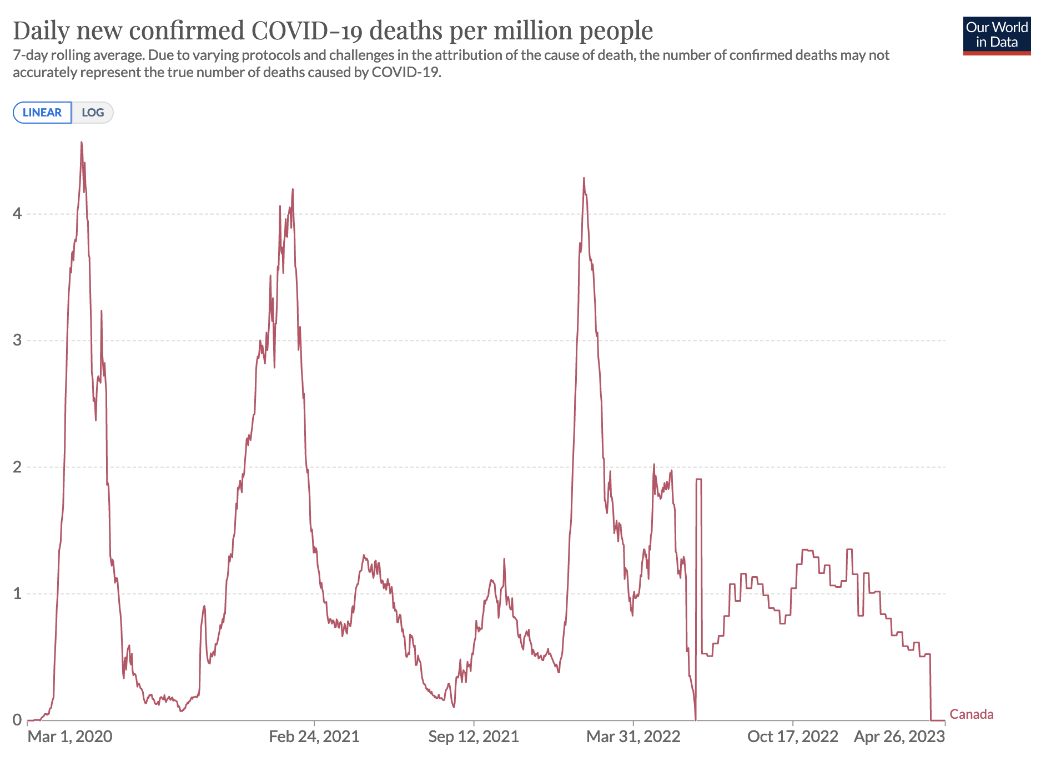
Vaccines Mandates, Problem 2.
The Chief benefit of the vaccine is drastic reduction in severity of illness.
Deaths during Delta
variant.

Slide 28
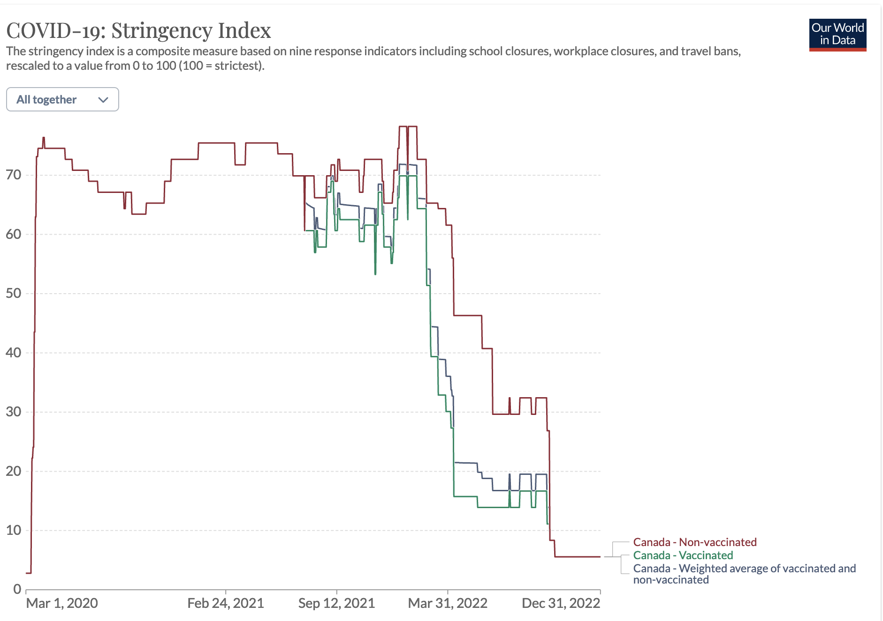
This means that vaccines were mostly a PRIVATE GOOD.
A core tenant of human rights is the freedom to decide PRIVATE GOODS.
This will go down as a
shameful episode in
Canadian history.

Slide 29
How To Prevent a Future Relapse?
- The truth has to come out and be spread widely. Or at least documented and easily available.
More restraints have to be placed on PHOs. They should have to quickly justify, along
legitimate cost/benefit procedures, what they are doing.
- I do not understand why the Press was unwilling to publish academic results that called into question the health orders, but this must be encouraged.
- “Lockdown” and “Mandates” should require Legislative authority.
PHOs and Politicians should NOT be held to any account (other than the ballot box) if they
make a mistake in good faith.

