Slide 1
COVID-19 Vaccines A Harm Benefit Analysis
Dr. Joseph Fraiman
Notes:
Introduce yourself

Slide 2
Early COVID-19 Pandemic Experience in the Emergency Room
Notes:
Story of the first couple of surges
In 2020 through 2021 there were stories of COVID-19 hospitalizations and deaths after being hit by a car, or some unrelated hospitalization. I can not speak for the rest of the country and other hospitals but in my experience this was quite rare.
The counters for cases, hospitalization and death were a surreal experience in how reliable they were.
the only other experience I can relate it to, is looking up the weather seeing its 70 degrees, then going outside and thinking to yourself, yep that does feel like 70.

Slide 3
Pfizer mRNA COVID-19 Vaccine Randomized Controlled Trial
Notes:
Polack, F. P., Thomas, S. J., Kitchin, N., Absalon, J., Gurtman, A., Lockhart, S., ... & Gruber, W. C. (2020). Safety and efficacy of the BNT162b2 mRNA Covid-19 vaccine. New England journal of medicine, 383(27), 2603-2615.

Slide 4
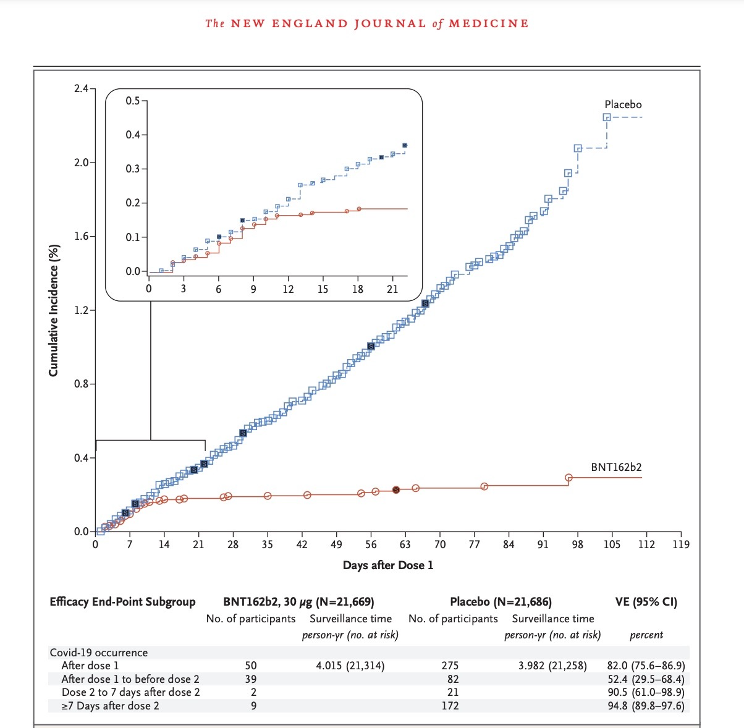
Pfizer COVID-19 Vaccine Efficacy Symptomatic Infection
Notes:
Add graph

Slide 5
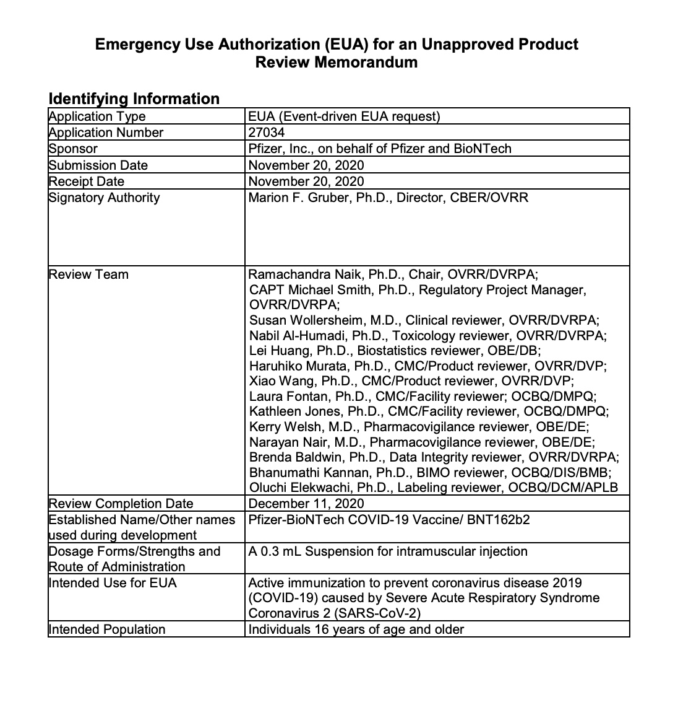
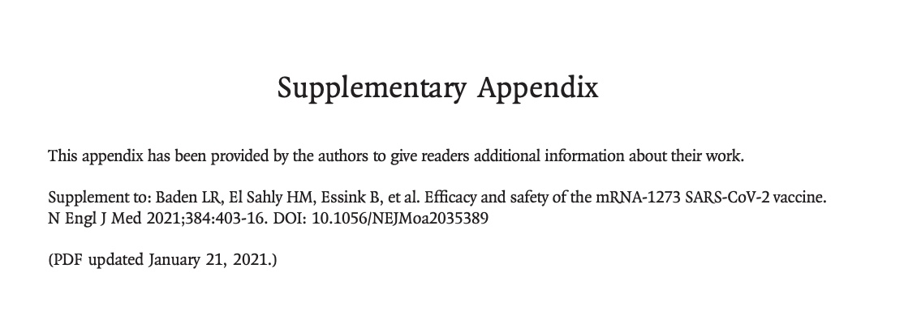
mRNA COVID-19 Vaccine Efficacy COVID-19 Hospitalization
Pfizer
Moderna
Notes:
https://www.nejm.org/doi/suppl/10.1056/NEJMoa2035389/suppl_file/nejmoa2035389_appendix.pdf
https://www.fda.gov/media/144416/download#page=30
Table S14

Slide 6
Pfizer Vaccine Efficacy COVID-19 Hospitalizations
Vaccine 0
Placebo
5
Hospital Reduction
2.3 per 10,000 Participants
Notes:
0 VS 5
write zero vaccine hospitalizations
or 0 vs 5

Slide 7
Moderna Vaccine Efficacy COVID-19 Hospitalizations
Vaccine 0
Placebo
9
Hospital Reduction
6.4 per 10,000 Participants
Notes:
0 VS 5
write zero vaccine hospitalizations
or 0 vs 5

Slide 8
Pfizer Vaccine Efficacy COVID-19 Death Reduction
Notes:
Thomas, S. J., Moreira Jr, E. D., Kitchin, N., Absalon, J., Gurtman, A., Lockhart, S., ... & Jansen, K. U. (2021). Safety and efficacy of the BNT162b2 mRNA Covid-19 vaccine through 6 months. New England Journal of Medicine, 385(19), 1761-1773.

Slide 9
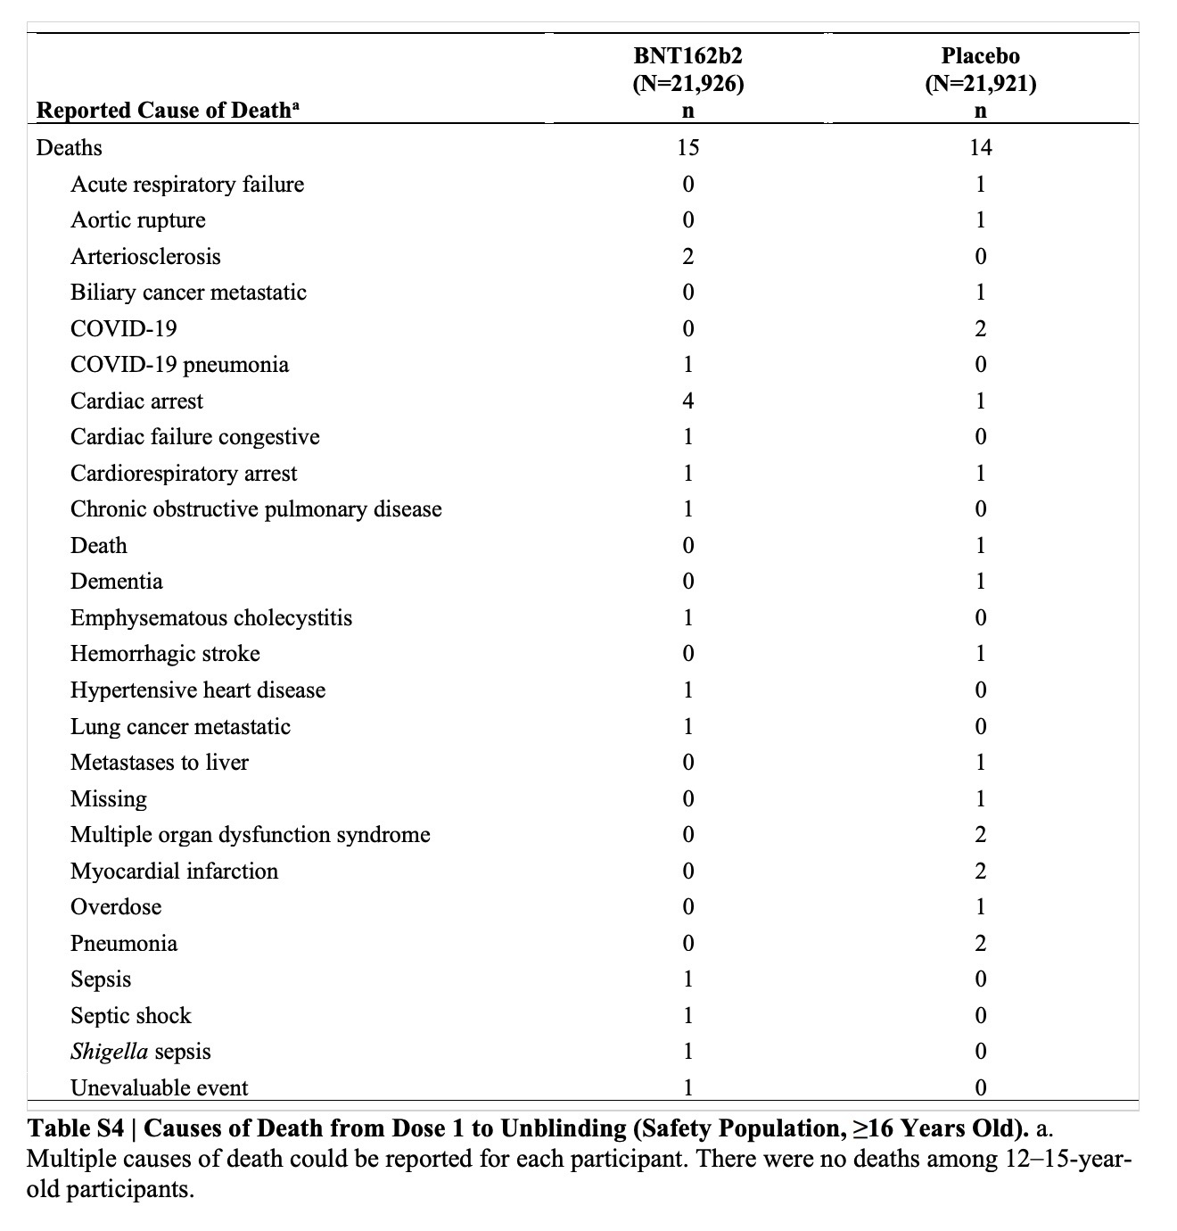
Pfizer mRNA COVID-19 Vaccine Efficacy COVID-19 All-Cause Death
Notes:
death reduction

Slide 10
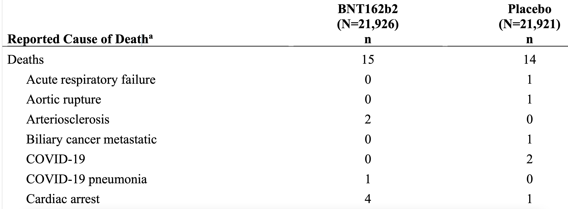
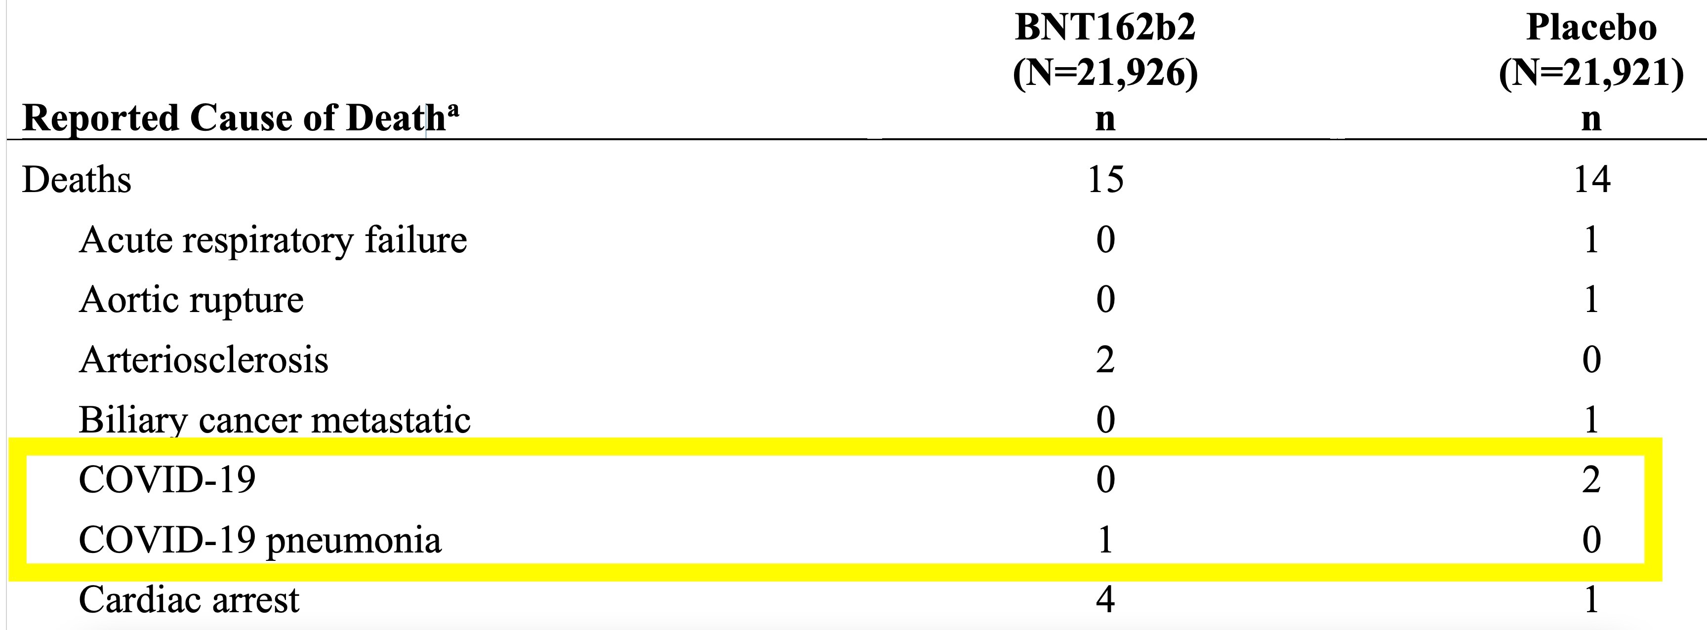
Pfizer mRNA COVID-19 Vaccine Efficacy COVID-19 Death
Notes:
Summary

Slide 11
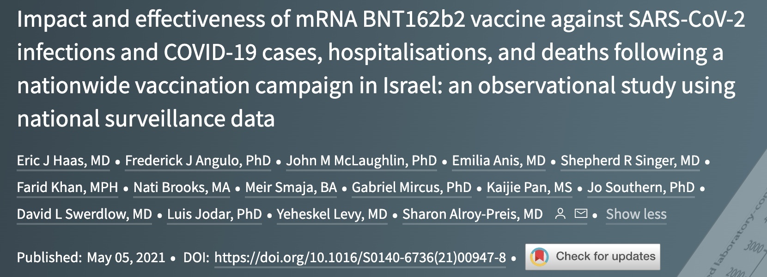
Observational Data of Vaccine Efficacy

Slide 12
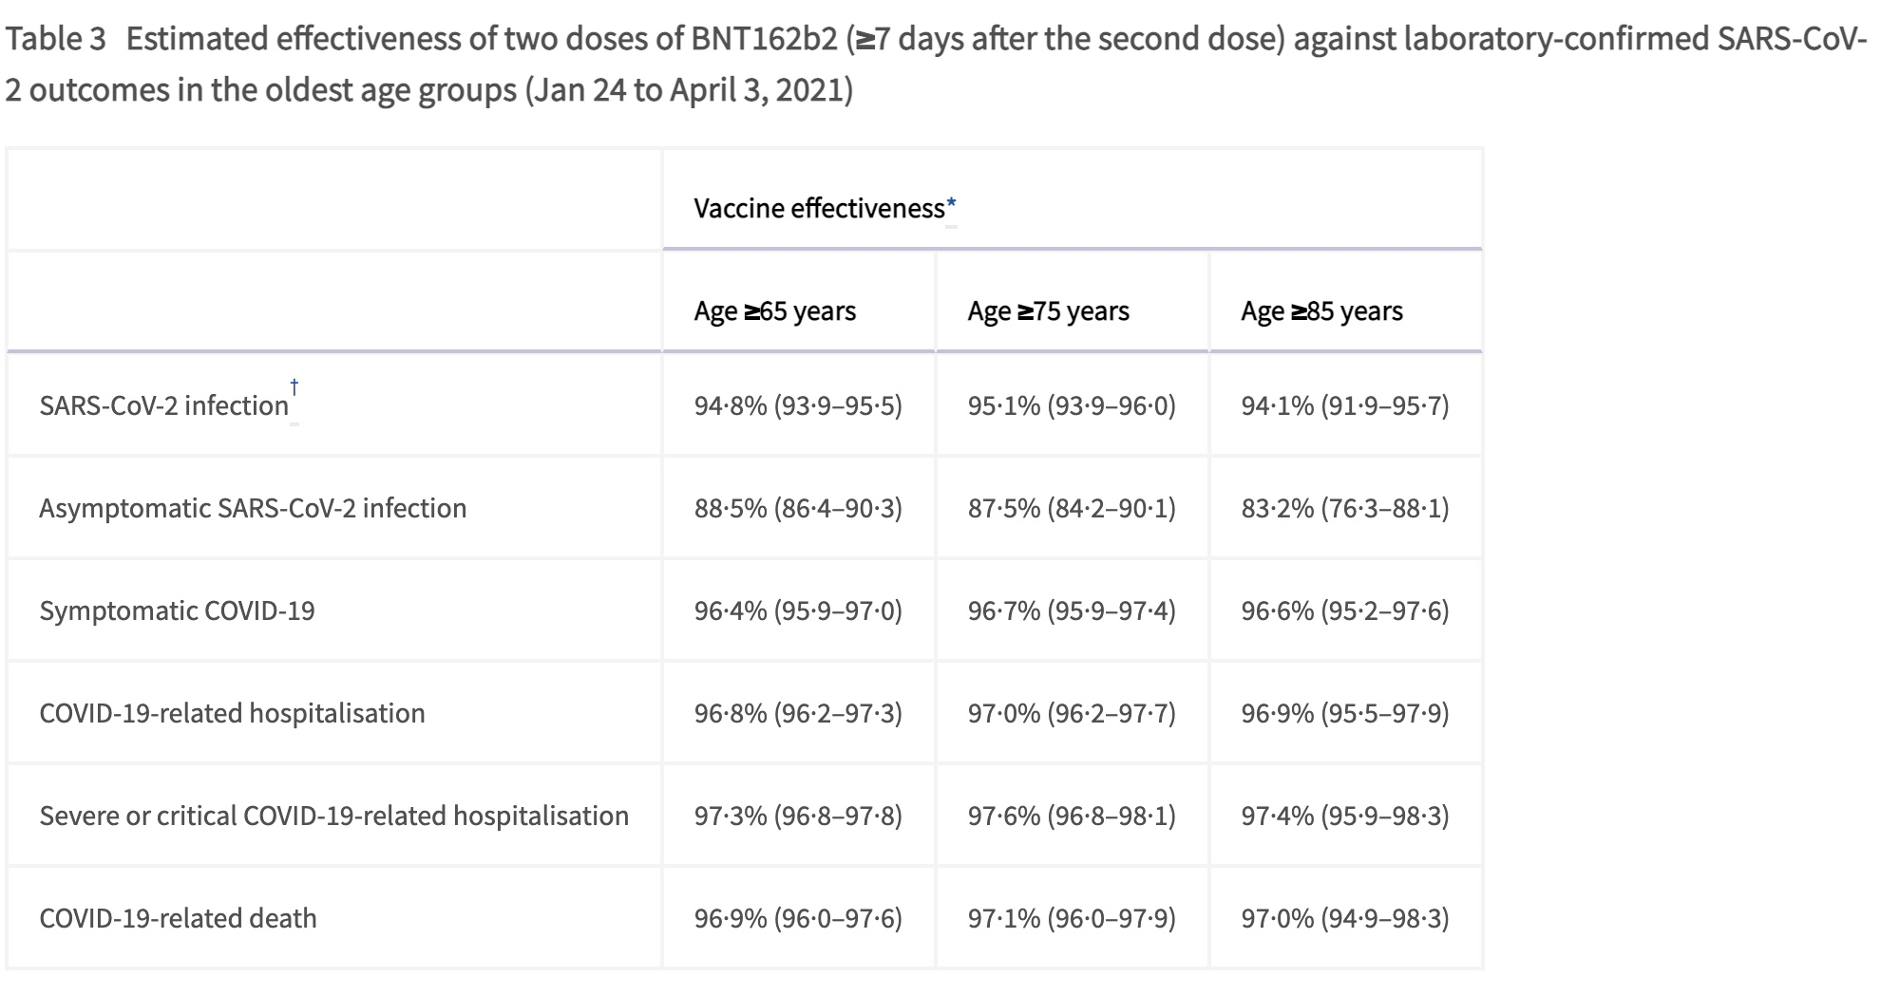
Observational Data of Vaccine Efficacy

Slide 13
COVID-19 Emergency Room Experience Post-Vaccine
Notes:
Following authorization I did not see a single vaccinated person come into my ER with COVID, From January 2021 until about April, then we started seeing more and more vaccinated coming into the ER positive for COVID
miscategorized hospitalization by vaccination status
At this time while overall hospitalization rate remained reliable, once vaccinated began being hospitalized, I am uncertain how reliable our data was on hospitalization in vaccinated versus unvaccinated.
During this time I believe I saw maybe a handful of re-infection, and I do not believe I have ever witnessed a re-infection be hospitalized, but I am uncertain on this, as it isn’t as well kept track of as the vaccines.
January and February COVID cases and hospitalization started dropping, it looked like the vaccines were working. But what was very strange, the rapid responses were happening 2-3 times a day, but it wasn’t COVID but it seemed like a bunch of the things COVID is known to cause…remember early on when we would learn in t
docs were all seeing this and we were needing to transfer patients across state lines again, something no one remembered ever used to happen before COVID
First I want to continue with the original clinical trials on harms

Slide 14
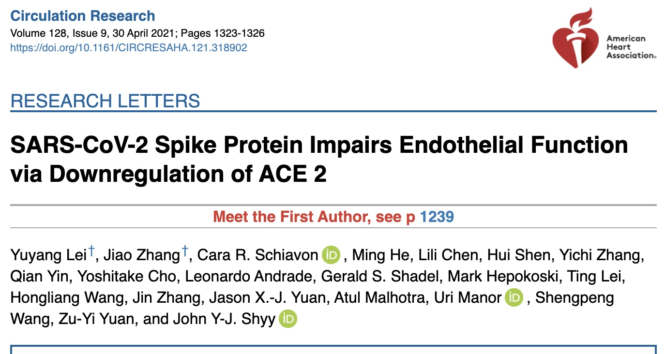

Slide 15
COVID-19 Vaccine Harm Analysis
Notes:
Polack, F. P., Thomas, S. J., Kitchin, N., Absalon, J., Gurtman, A., Lockhart, S., ... & Gruber, W. C. (2020). Safety and efficacy of the BNT162b2 mRNA Covid-19 vaccine. New England journal of medicine, 383(27), 2603-2615.

Slide 16
mRNA COVID-19 Vaccines Randomized Controlled Trials
Notes:
Polack, F. P., Thomas, S. J., Kitchin, N., Absalon, J., Gurtman, A., Lockhart, S., ... & Gruber, W. C. (2020). Safety and efficacy of the BNT162b2 mRNA Covid-19 vaccine. New England journal of medicine, 383(27), 2603-2615.

Slide 17
Notes:
Put in old slide NEJM

Slide 18
Serious Adverse Event (SAE) Definition

Slide 19
https://www.fda.gov/media/144246/download

Slide 22
COVID-19 mRNA Vaccines Number of Serious Adverse Events

Slide 23
COVID-19 mRNA Vaccines Number of Serious Adverse Events

Slide 24
COVID-19 Vaccine Pfizer Clinical Trials Number of Serious Adverse Events
Risk Increase in Vaccine group (95% CI)
Risk difference | Risk Ratio
18 Per 10,000 (1.2-34.9) | 1.36 (1.02-1.83)
Notes:
Explain the confidence intervals

Slide 25
Pfizer mRNA COVID-19 Vaccine Serious Adverse Events
36%
Higher risk of SAE
in vaccine group

Slide 26
Pfizer mRNA COVID-19 Vaccine Serious Adverse Events
1 in 555
Additional SAE
in vaccine group
Notes:
1 additional Serious Adverse Event for every 555 people vaccinated
The only difference between these two groups is one took the vaccine and one got placebo, typically this is how we establish a relationship is causal.
New Slide on rate of serious harm from other vaccines

Slide 27
What Type of Serious Harms?

Slide 28
Adverse Events of Special Interest (AESI)

Slide 29
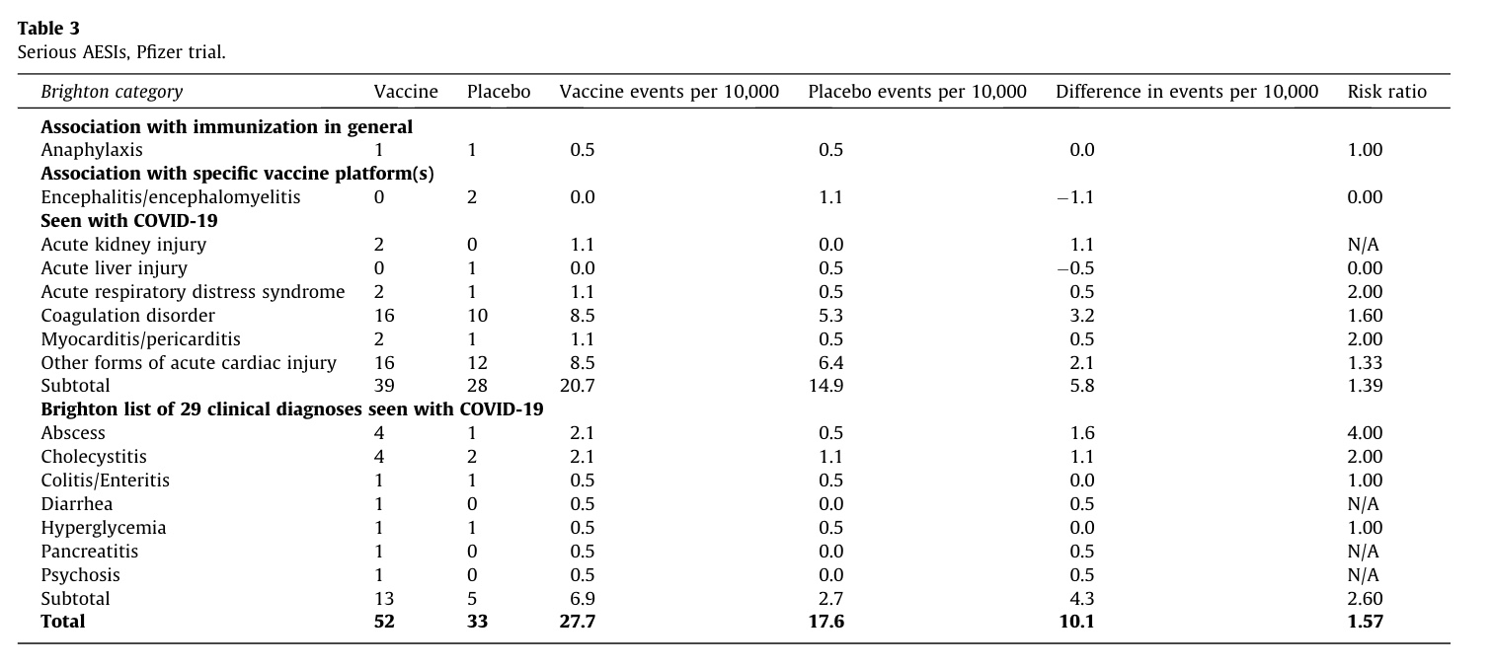
Notes:
15

Slide 30
Notes:
15

Slide 31
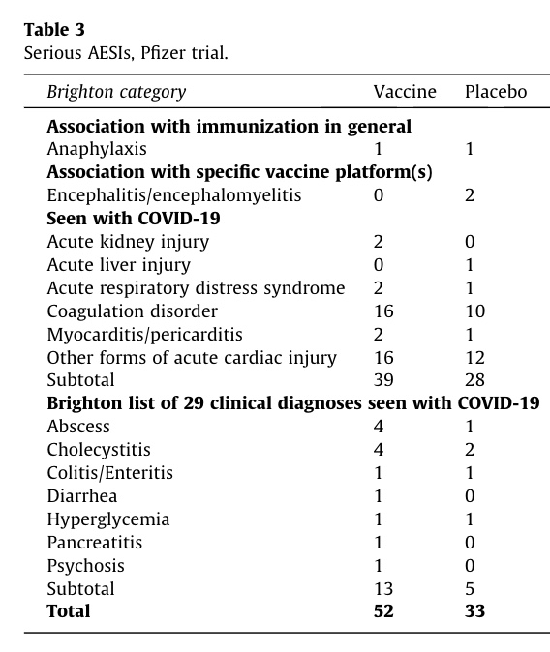
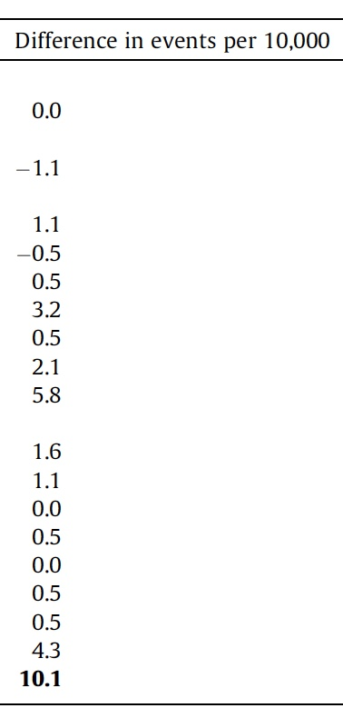
Notes:
15

Slide 32
Multiple Rare Serious Harms Add Up
Notes:
The COVID-19 Vaccine may cause
Many different types of serious harm, but each harm is rare
If vaccine causes 20 different types of serious harm
If each serious harm is occurs at a rate of 1 in 10,000
The rate of serious harm will be 1 in 500
Add slide on coagulation disorders

Slide 33
COVID-19 mRNA Vaccines and Serious AESIs
Notes:
Slide for Combined

Slide 34
COVID-19 mRNA Vaccines and Serious AESIs
Notes:
Slide for Combined

Slide 35
Harms and Benefits: How can they be compared?

Slide 36
mRNA COVID-19 Vaccine Clinical Trials All-Cause Hospitalization
Notes:
Erase ??
Harm benefit analysis slide

Slide 37
Harms and Benefits: How can they be compared?
Serious AESI vs Hospitalization Reduction

Slide 38
Pfizer Vaccine Efficacy COVID-19 Hospitalizations
Vaccine 0
Placebo
5
Hospital Reduction
2.3 per 10,000 Participants
Notes:
0 VS 5
write zero vaccine hospitalizations
or 0 vs 5

Slide 39
Pfizer Harm-Benefit Analysis AESI vs Hospitalization
Serious AESI risk
10.1
Per 10,000 Participants
Hospitalization Reduction
2.3
Per 10,000
Participants

Slide 40
Moderna Harm-Benefit Analysis AESI vs Hospitalization
Serious AESI risk
15.1
Per 10,000 Participants
Hospitalization Reduction
6.4
Per 10,000
Participants

Slide 41
Harm Benefit Analysis Limitations
https://doi.org/10.5281/zenodo.6564402
Notes:
Our study has been heavily criticized, with fact checkers calling various terminology they use to claim it is inaccurate, or misleading. To establish the facts, they felt the peer review of experts in the field chosen to review our paper by the editor of a preminent Vacinology journal, they felt they could rely on social media bloggers and you-tubers along with some comments from the FDA.
Bloggers and you-tubers claim to debunk our study, in fact one of the blogger has been referred to as an expert debunker.
I raise their limitations here as I find they are very useful for helping us how to interpret the results of our analysis.
Mention co-authors
“You can’t do a proper harm benefit analysis of a vaccine with only 2 months of data post vaccine.”
If the trial had gone longer,or a surge of COVID cases or if the trial had more older people, the hospitalization rate would be higher and this would have increased the benefit of hospitalization reduction.
My co-authors and I agree with this, as it is obvious true.
This clearly shows how the benefit of hospital reduction are not just a question of vaccine efficacy being 95%, it also depends on how high is the hospitalization rate.
I think and I even believe this is most likely, but I have to acknowledge it is also possible the benefits could have outweighed the harms identified.
We can also be certain the harm to benefit ratio, will remain on the hospitalization rate, vaccine effiacy,
However we do not know this for certain.
I think we can safely say the clinical trial data that the COVID-19 vaccine likely offered greater benefit than harm, as long as infection rates are high,
Today most have already been infected greatly reducing their chance of hospitalization, plus with Omicron we have a situation with a virus less likely to cause hospitalization, and it is known to be able to evade the immune protection of the vaccine reducing vaccine efficacy. All of these factors would would reduce the benefits, while harms would stay the same.

Slide 42
COVID-19 Emergency Room Omicron Experience
Notes:
End of 2021 early 2022 we saw the rise of Omicron
Case countrer stopped being accurate for hospitalizations
While most hospitalizations prior to COVID were nearly all do to COVID, with Omicron the reverse was true with nearly all patients hospitalized who had COVID nearly all were incidental
While some were potentially COVID related given it places people at risk for many conditions, but I really think most were clearly unrelated, and I personally actually have not admitted a patient for COVID-19 since February 2022 while want to be clear, I have seen another doctor admit a patient for OMICron covid, and I have responded to one call for help with an ICU Omicron patient, my experience may be anecdotal, I work in 4 hospitals, with many different ER nurses, all reporting a similar situation, as well as other ER hysicians I know all reporting the COVID-19 hospitalizations are incredibly rare
The anecdotal experiences of myself and fellow ER doctors and nurses should not be thought of as simply anecdotal. While if you ask an ER doctor what it is the rate of hospital admissions per population for heart attacks strokes, pulmanry embolism, and aortic dissection my guess is none would know the number off the top of their head, but my guess is every one could heart attacks are a bit more common than strokes, which are more common than pulmonary embolism, while aortic dissection, I rarely see that.
I was responding to 2-3 resucitations a day at high points of the surge, and now I have not even hospitalized a patient in over a year.

Slide 43
Incidental COVID-19 Hospitalization During Omicron

Slide 44
Incidental COVID-19 Hospitalization During Omicron
“The share of deaths of COVID-19 (as opposed to with COVID-19) fell from 60–75% before week 1/2022 to 25–35% in the following months.”
Notes:
bold important part

Slide 45
Protection from Prior Infection

Slide 46
“protection against severe disease remained high for all variants, with 90·2% (69·7–97·5) for ancestral, alpha, and delta variants, and 88·9% (84·7–90·9) for omicron BA.1 at 40 weeks.”

Slide 47
Omicron Hospitalizations

Slide 48
Notes:
4.7 Million patients in Kaiser system
Over 200,000 tested positive during Omicron
ICU admission was 11 in 10,000 for delta vs 2 for omicron, ventilation was 7 versus 1

Slide 49
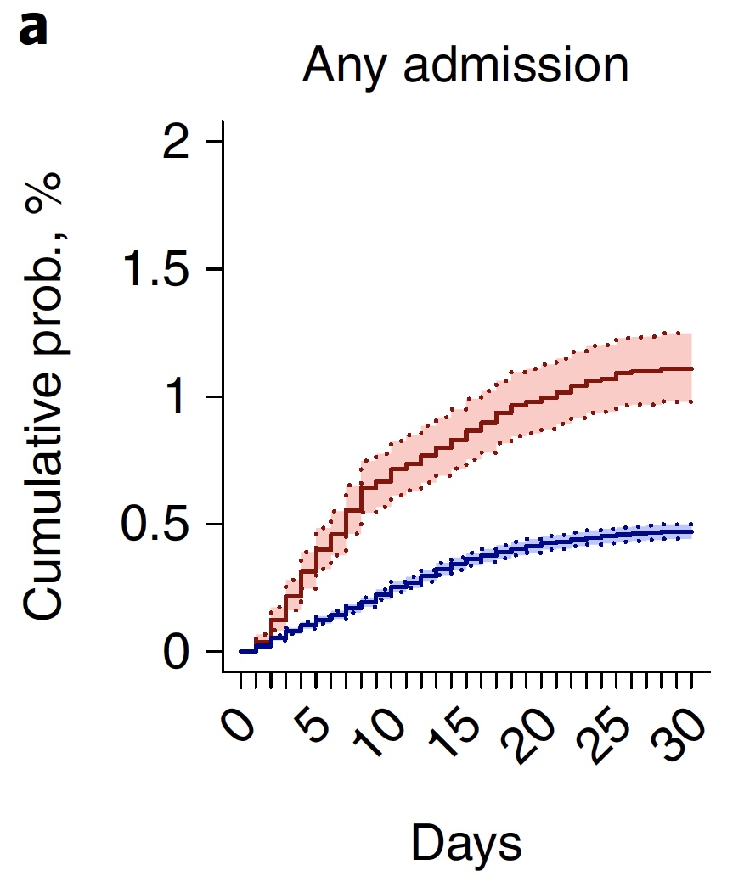
Notes:
enlarge split in two

Slide 50
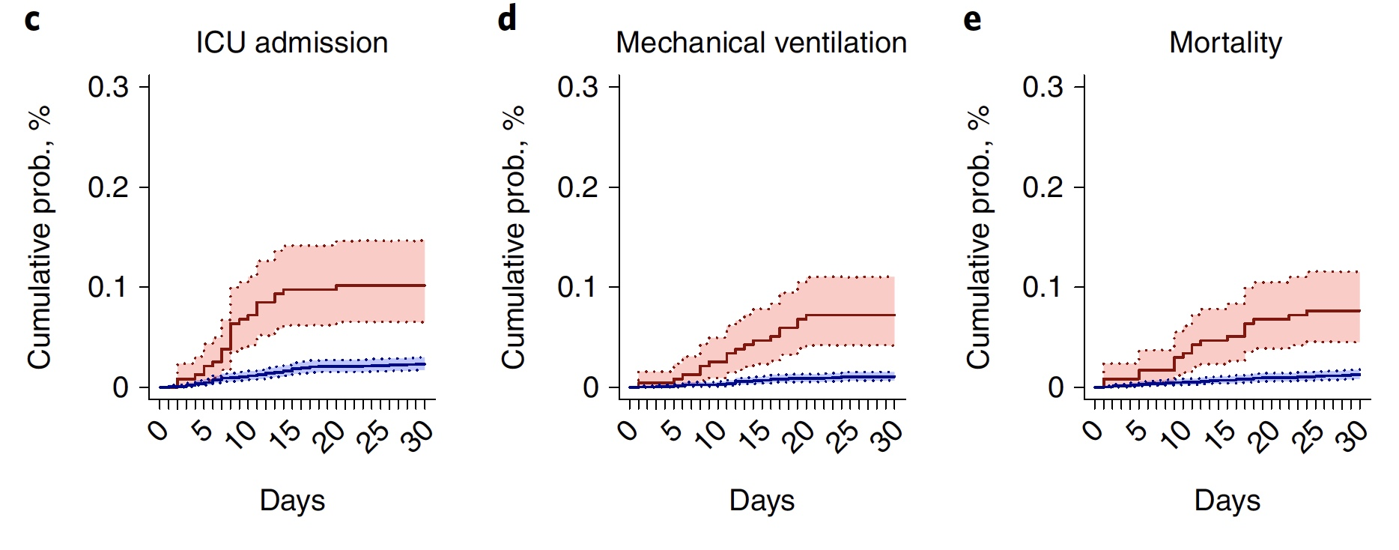
Notes:
enlarge split in two

Slide 51
Vaccine Efficacy COVID-19 Hospitalization Reduction Omicron

Slide 52
Vaccine Efficacy During Omicron COVID-19 Hospitalization Reduction

Slide 53
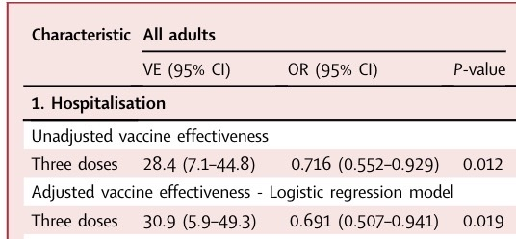
Vaccine Efficacy During Omicron COVID-19 Hospitalization Reduction

Slide 54
Vaccine Efficacy During Omicron COVID-19 Hospitalization Reduction

Slide 55
CDC Estimate Vaccine Efficacy During Omicron

Slide 56
CDC Estimate Vaccine Efficacy During Omicron

Slide 57
COVID-19 mRNA Vaccine Omicron Hospitalization Reduction Is Uncertain
Notes:
Hospitalization rates are unreliable
Hospitalization rates are lower
Vaccine Efficacy is lower

Slide 58
COVID-19 Vaccines can cause serious harm
Notes:
But we don’t know exactly what type of serious harm, or how frequent each type of harm is.

Slide 59
How can we be confident COVID-19 Vaccines benefits outweigh the Harms?
Notes:
We can not rely on Observational data to continue to recommend boosters which are potentially causing more harm than benefit indefinitely.
Our governmental agency safety surveillance system is totally inadequate to identify a harm profile of small increases in multiple common serious events

Slide 60
Double Blind Randomized Clinical Trials (RCT) for All-Cause Hospitalization
Notes:
Demand Pfizer and Moderna to release all-cause hospitalization data
Must release all cause-hospitalization data including and excluding COVID-19, to allow comparison with current varients
If all cause hospitalization is increased in original RCTs COVID-19 vaccines should be withdrawn
If all cause hospitalization is similar between groups a moratorium must be placed on COVID-19 vaccines and RCTs commenced
RCT should begin in those over 70, and demonstrate evidence of COVID-19 hospitalization reduction without showing increase in all-cause hospitalization.

Slide 61
Questions?
Notes:
Demand Pfizer and Moderna to release all-cause hospitalization data
Must release all cause-hospitalization data including and excluding COVID-19, to allow comparison with current varients
If all cause hospitalization is increased in original RCTs COVID-19 vaccines should be withdrawn
If all cause hospitalization is similar between groups a moratorium must be placed on COVID-19 vaccines and RCTs commenced
RCT should begin in those over 70, and demonstrate evidence of COVID-19 hospitalization reduction without showing increase in all-cause hospitalization.

