Slide 1
INDEPENDENT ANALYSIS OF QUALITY AND NON-CLINICAL ISSUES OF THE BNT162B2 VACCINE IDENTIFIED BY THE EUROPEAN MEDICINES AGENCY
L. Maria Gutschi, BScPhm, PharmD April 20, 2023
Acknowledgements: Helene Banoun PhD, David Wiseman MRSPharm PhD

Slide 2
EUROPEAN MEDICINES AGENCY (EMA)
Regulators all work from the Common Technical Document (eCTD)
Rolling review assessment means data analyzed as it became available, and wait not until the submission was complete
Pivotal trial (Polock et al NEJM) published in November 2020
BioNTech/Pfizer vaccine approved under Conditional Marketing Authority by the EMA December 20, 2020, Canada was a week earlier
European Public Assessment Report (EPAR) Dec 2020
  Specific Obligations for manufacturing imposed
Leak of confidential documents to “dark web” January 2021

Slide 3
Steps in manufacturing
280 components
Several different manufacturers
25 different suppliers
Ultra-cold storage
Rapid transportation between sites
https://www.citizen.org/article/how-to-make-enough-vaccine-for-the-world-in-one-year/

Slide 4
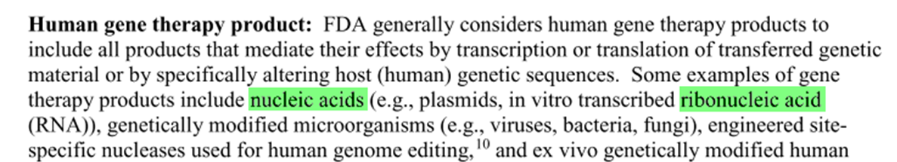
Regulatory review: Vaccine or gene therapy?
Regulatory status is complex, contradictory, unclear
Objectively a genetic therapy
  EMA 2001 amended in 2012: mRNA products to be evaluated similarly as all vaccines
  FDA 2013: regulation of gene therapy products did not apply to vaccines vs infectious diseases
  EMA 2016: specifically excluded from Gene Therapy Medicinal Products
  FDA 2017: excluded from long term studies for genetic therapies
  WHO 2005 guidelines for non-clinical evaluation was used; grants nucleic acid-based vaccines status as vaccines
    Delineates controls, GMP for purity/quality, other studies if new formulation
    Moderna in SEC filing June 2020
      "currently, mRNA is considered a gene therapy product by the FDA"
    BioNTech founder Ugur Sahin in 2014
      "One would expect the classification of an mRNA drug to be a biologic, gene therapy, or somatic cell therapy

Slide 5
Manufacturing the mRNA
DNA plasmid grown in E coli cells
Linearized DNA
In vitro transcription
  modRNA
  Purification
Scaling up to make millions of doses had not been done
Unforseen issues
https://www.sciencedirect.com/science/article/pii/S0264410X21003194

Slide 6
Issues with IVT and purification with commercial batches
 | Process 1 (Clinical trial batches) | Process 2 (Commercial batches) | Comments
DNA template | PCR amplified | Linearized plasmid DNA | Information on control and analytical methods for linearized DNA plasmid was pending at time of CMA Stability of the linear DNA and filtered circular plasmid DNA intermediate should be addressed Changes in manufacturing requires a Variation Application to EMA
BNT162b2 characterisation | HPLC-UV and LC/MS/MS – oligonucleotide mapping Illumina MiSeq Next Generation Sequencing (NGS) Circular dichroism spectroscopy to confirm higher order structure |  | Fragments corresponding to 90.5% of BNT162b2 sequence detected Process 1 and 2 were comparable No method for determining intact RNA included
BNT162b2 Manufacturing Steps | In vitro transcription followed by: DNase I digestion NA Magnetic bead purification Final filtration and dispense | In vitro transcription followed by: DNase I digestion Protein K digestion Ultrafiltration/ Diafiltration Final filtration and dispense | Magnetic bead purification not scalable and replaced with protein K digestion and filtration 5’ cap analogue
Scale | 0.35L-0.72L | 37.6L | Only limited data available for commercial scale batches at CMA
RNA integrity (%) | 78.1-82.8% | 59.7% | Specific Obligation
In vitro expression of BNT162b2 | Consistent/expected size | Consistent/expected size | Specific Obligation
5’ cap by LC-UV/MS (%) | 56-67% | 83% | Slightly higher capping levels in process 2 was considered acceptable
Poly (A) tail (%) Poly (A) tail length and distribution (RP-HPLC-UV) | 116-127% A30: 28-34A A70: narrow range | 93-104% A30: 28-34A A70: longer tails | Significant differences found with poly (A) tail pattern
dsRNA (pg/ug RNA) | <80 to<120 | NMT 240 | Higher levels with process 2 noted
Residual DNA template (ng/mg RNA) | 1-<200 | 17-211 | Increased levels seen in latest commercial batch
In vitro transcription from linearized DNA
  Fragmented/truncated mRNA
  Uncapped mRNA
  No poly (A) tail or differing lengths
  Other contaminants
    dsDNA
    dsRNA
    Endotoxin

Slide 7
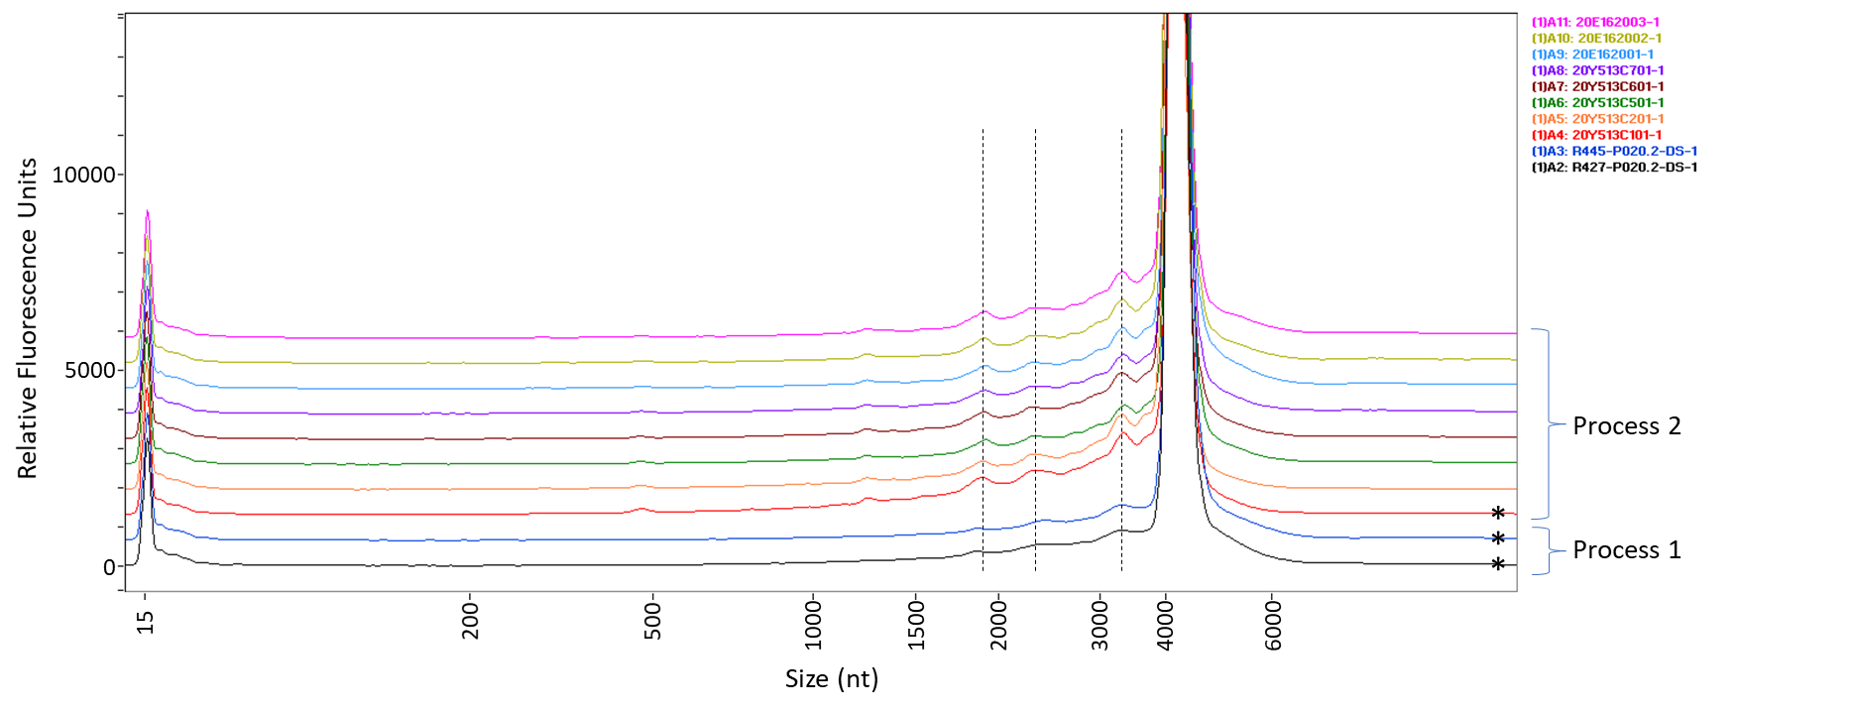
EMA: The potential safety risks associated with truncated RNA isoforms should be thoroughly discussed with reference to the batches used, clinical experience and possibly literature data. The quantitative and qualitative differences observed between Process 1 and 2 should be discussed with respect to their impact on safety and efficacy.
Pfizer/BioNTech Response: The electropherograms comparing process 1 and process 2 drug substance batches, inclusive of clinical, emergency supply and PPQ batches, are provided. The major fragments are common between both processes. Truncated transcripts are not expected to impact safety and as they would be degraded or not translated.
COVID-19 Vaccine EMA/Rapporteur CMC Meeting:

Slide 8
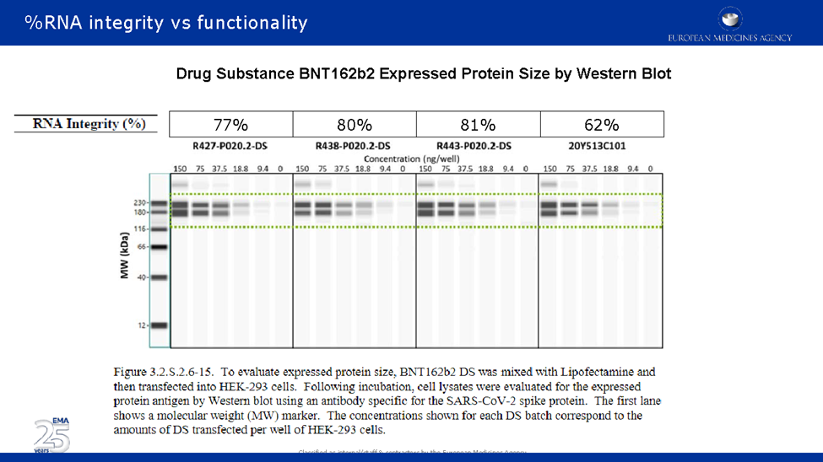
COMMERCIAL PRODUCT NOT THE SAME AS USED IN THE CLINICAL TRIALS

Slide 9
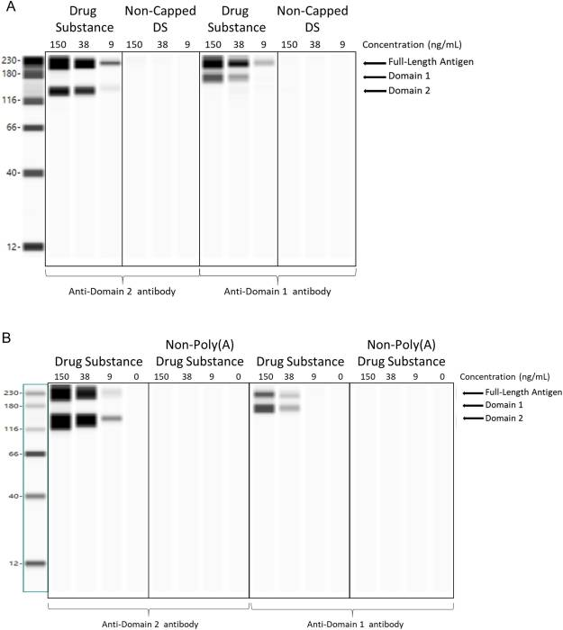
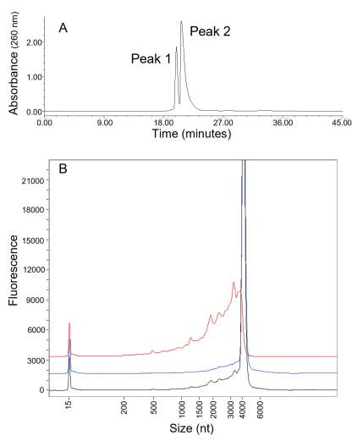
ARE THE FRAGMENTED MRNA GETTING TRANSLATED?
Patel HK, et al. Characterization of BNT162b2 mRNA to Evaluate Risk of Off-Target Antigen Translation. J Pharm Sci. 2023 Jan 13:S0022-3549(23)00009-6. doi: 10.1016/j.xphs.2023.01.007. Epub ahead of print. PMID: 36642376; PMCID: PMC9836996.
Specific Obligation imposed by the EMA Dec 2020
Fulfilled Feb 2022
Pfizer scientists published in scientific paper these do not get translated
  Do they have intrinsic immune activity?
  Can they act as miRNAs?
  Can the poly (A) tail gets re-polyadenylated in vivo
How do they get broken down?
Have any of the fragmented mRNA been sequenced or analyzed by MS?
https://www.ncbi.nlm.nih.gov/pmc/articles/PMC9836996/

Slide 10
The mRNA is BIOsynthetic and modified
https://www.sec.gov/Archives/edgar/data/1682852/000168285221000006/mrna-20201231.htm
Kim, S., Sekhon, S.S., Shin, WR. et al. Modifications of mRNA vaccine structural elements for improving mRNA stability and translation efficiency. Mol. Cell. Toxicol. 18, 1–8 (2022). https://doi.org/10.1007/s13273-021-00171-4
WHY DO CODON OPTIMIZATION?
Different nucleic acids (triplet codon) but same amino acid and same protein sequence
  Decreases immunostimulatory activity of the viral mRNA
  Facilitates ribosomal translation into spike protein for immune response
Human elements for 3’-UTR and 5’-UTR
N1-methyl-pseudouridine replaced for every uridine in the open reading frame
  0.3-0.6% of human nucleic acids; common in Archaebaceteria which are extremophiles
IS THIS NORMAL MRNA?
L. Maria Gutschi, BScPhm, PharmD
Notes:
Kevin McKernan
Quadraplex G formation
Read through of the stop codons possible
Unknown if there is aberrant protein production
Patterson
Magen
Errors on translation

Slide 11
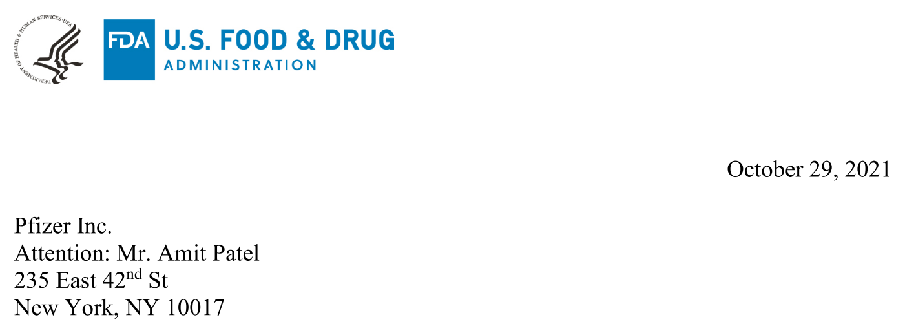
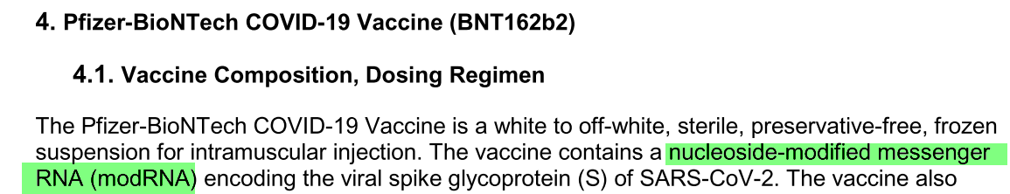
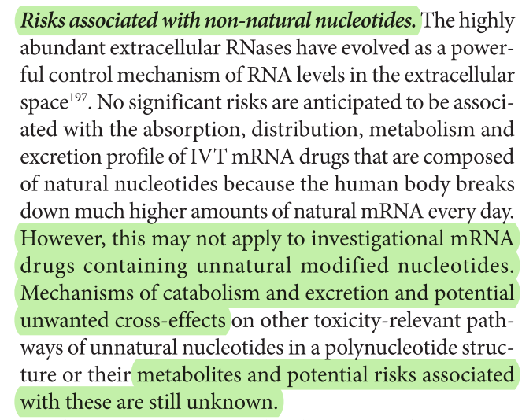
No cumulative tox data
“Nucleoside modified messenger RNA (modRNA)”
https://cacmap.fda.gov/media/150386/download
Page 11: fda.gov/media/144245/download
non-natural nucleosides AND human gene sequences
“anti-RNA antibodies […] immune pathology.”
“potential toxicity of nucleoside analogues”
“metabolites and potential risks […] unknown.”
“adverse effects […] prolonged treatment with nucleoside analogues. “
“mitochondrial toxicities”
Sahin et al., 2014
Uridine → pseudouridine
David M Wiseman, PhD, MRPharmS 2023

Slide 12

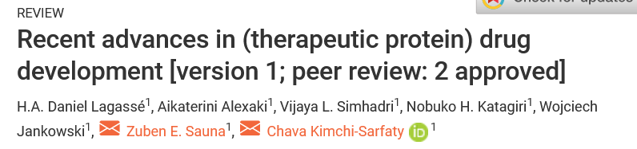
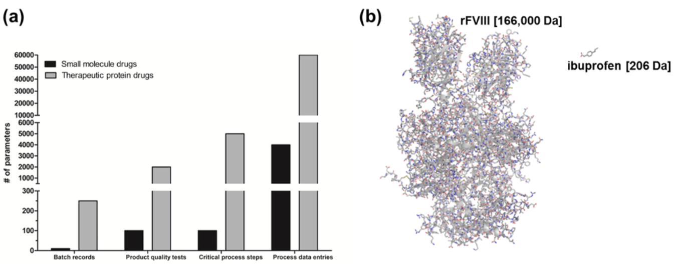
THE TROUBLE WITH CODON OPTIMIZATION
Current assumption is that the spike protein produced by the modRNA vaccine is the same as that of the virus. BUT IS IT?
“…although synonymous codons do not alter protein sequence, they can have profound effects on protein folding and function. Consequently, these therapeutic proteins designed by using such strategies will have to be carefully evaluated.”
Maintenance of secondary and tertiary folding

Slide 13
WHAT HAPPENS TO THE modRNA?
2015
“no RNA or protein metabolism or excretion studies will be conducted. The protein encoded by the RNA in BNT162b2 is expected to be proteolytically degraded like other endogenous proteins. RNA is degraded by cellular RNases and subjected to nucleic acid metabolism. Nucleotide metabolism occurs continuously within the cell, with the nucleoside being degraded to waste products and excreted or recycled for nucleotide synthesis.” Pfizer, 2021. Pfizer vaccine nonclinical overview, FDA-CBER, https://phmpt.org/wp-content/uploads/2022/03/125742_S1_M2_24_nonclinical-overview.pdf pg20/36 obtained from FOAI request.
    “As the active substance is a vaccine product (which additionally is based on naturally degradable mRNA and lipids), no environment risk assessment (ERA) is considered necessary.” Rapporteur’s Rolling Review Report Overview LoQ-COVID-19 mRNA Vaccine BioNTech Available at: https://covidvaccinereactions.com/ema-pfizer-leak/
Lymphoid tissue contains “vaccine mRNA and spike antigen up to 8 weeks postvaccination”

Slide 14
PRO-VACCINE: spike expression
?
modRNA acts as a ‘pro-drug’ as it gets converted to the ‘active drug’ (spike protein) intracellularly
EMA Rolling review Nov 2020
Became a Special Obligation
“A severe deficiency of the characterisation section is that no biological characterisation is presented and that the mode of action is not described. This is not found acceptable and the dossier should be updated with relevant information.
Wuhan spike
141 kDa
Spike protein produced by synthetic mRNA

Slide 15
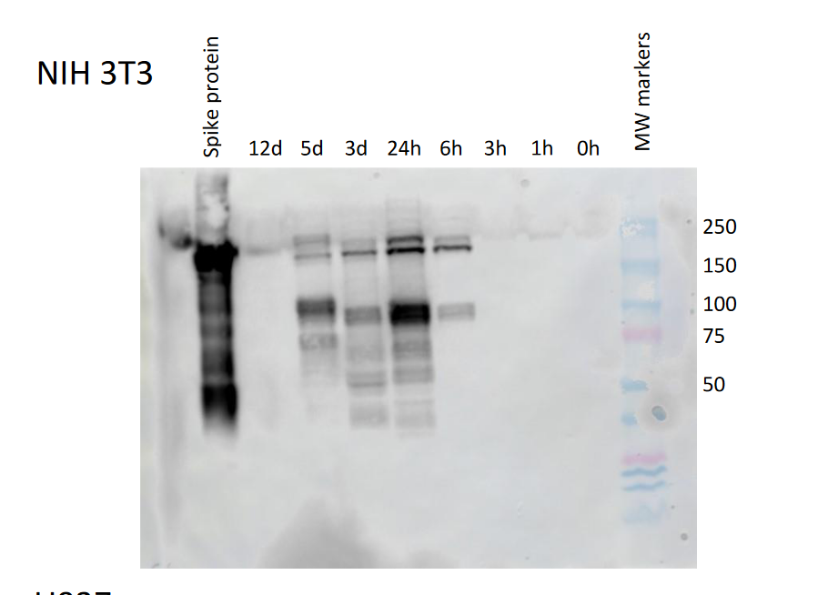
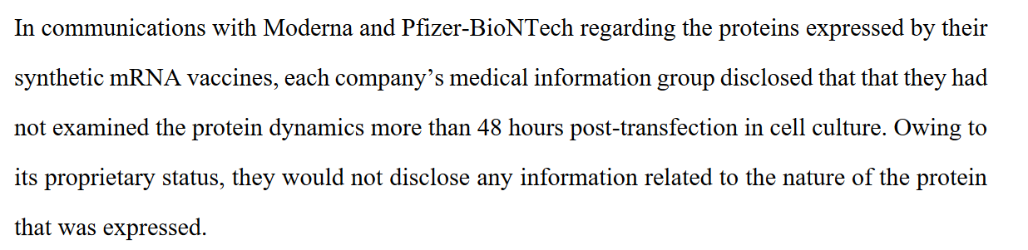
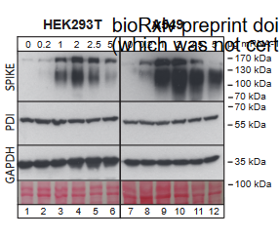
Where’s Waldo? Looking for the spike protein
Universities, institutes, biopharma have not sequenced the spike protein produced by the vaccines
Veenstra et al March 2022
Krawczyk et al Dec 2022
  Repolyadenylation of mRNA in vivo (Moderna)
Patterson et al 2021; mutant S1 spike sequences in monocytes
https://www.medrxiv.org/content/10.1101/2022.03.01.22271618v1.full.pdf
CENSORED
https://www.biorxiv.org/content/10.1101/2022.12.01.518149v2.full.pdf

Slide 16
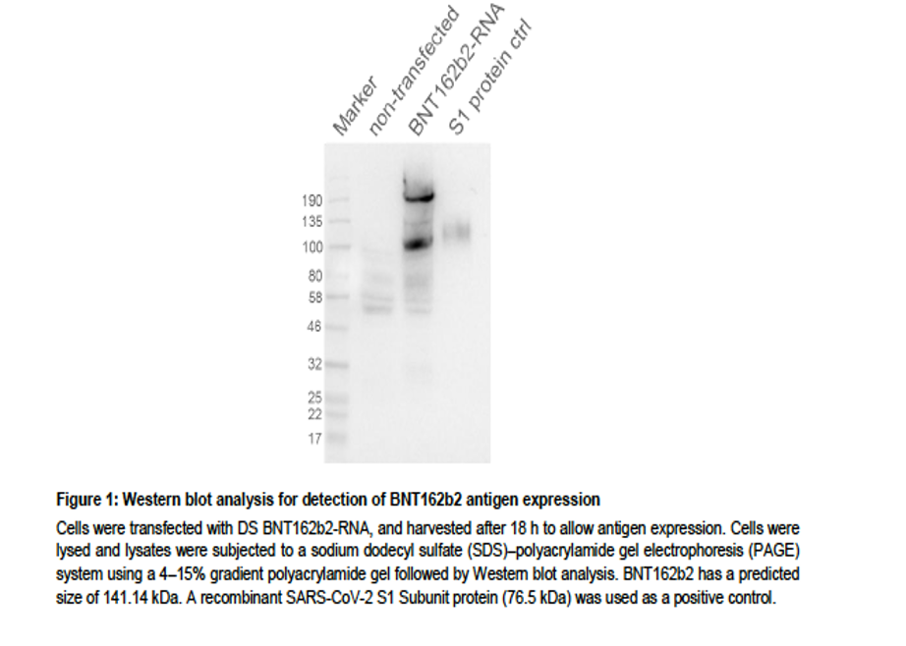
Characterization: SO1
EMA Rolling Review Nov 2020
Study 20-0211; regarding the results obtained from the Western Blot, a semi quantitative analysis of the results to improve the readability of the protein expression should be provided and in the analysis of the blot, some missing scientific information and explanations should be added by the applicant (CoRapp 8):
a. The presence of the two bands for BNT162b2 ARN (at 100 kD and 190 kD respectively)
b. The 76.5 kD bands are not observed in both BNT162b2 nor in S1 control lanes, and the full S protein at 141.14 kD is also not observed in BNT162b2 lane.
The lack of an important expression for the S1 protein control at 76.5 kD
EMA: Strip off sugars and confirm with LC-MS
Fulfilled Feb 2022; confirmation with MS pending
Judicial Watch FOIA request
https://phmpt.org/wp-content/uploads/2023/02/125742_S1_M4_4.2.1-r-20-0211.pdf

Slide 17
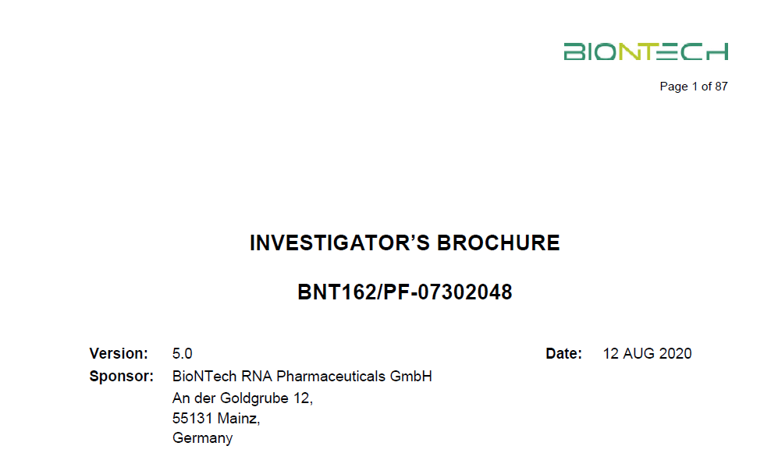
POTENCY
To confirm proportion of cells expression spike protein
Measure of transfection rate using the final product
Cell flow cytometry assay used by BioNTech considered suboptimal by EMA reviewers
Does not quantify if the expressed spike protein will elicit the desired immune response in vivo
Acceptance criteria needed justification by EMA reviewers
https://phmpt.org/wp-content/uploads/2023/02/125742_S1_M4_4.2.1-r-20-0211.pdf
RNA batch: RNA-RF200321-06, 97.5% integrity
• Polymun batch RBP020.2 LNP with the lot: CoVVAC/270320

Slide 18
THE PROBLEMS WITH POTENCY TESTING
How to evaluate when the vaccine type is new or is a new platform technology?
Correlate of protection vs SARS-CoV2 is not known
What type of immune response is necessary?
Potency dependent on transfection rate and then expression of the antigen (spike protein)
What assays to use? (western blot, flow cytometry)
In vitro tests used; animal potency assays not considered practical
Keith Peden, PhD. Microbiologist, Division of Viral Products, Office of Vaccine, Research and Review, CBER, FDA
https://www.youtube.com/watch?v=xszK_ug7QEw

Slide 19
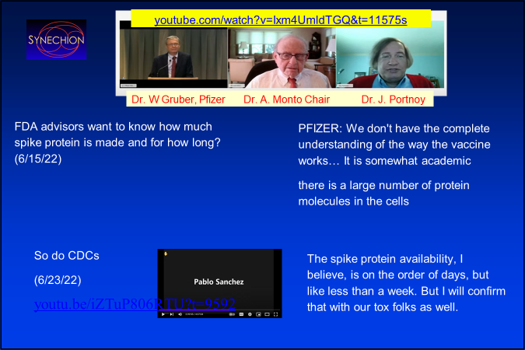
David Wiseman MRPharmS, PhD

Slide 20
LNP Manufacturing
Mixing of the LNPs are proprietary
Structure of the LNPs not really known
Stability of LNPs over time
  Increase in size dependent on time, temperature and pH
Size range of LNPs
  May affect distribution and efficacy
Encapsulation rate
  Approx 70-80%
Non compendial
  From grams to kg quantities
https://doi.org/10.3390/vaccines9010065
Ionic lipid ALC-0315
Pegylated lipid ALC-0159
Helper lipid DSPC
cholesterol

Slide 21
https://www.sciencedirect.com/science/article/pii/S0264410X21003194#section-cited-by
https://www.cell.com/biophysj/pdf/S0006-3495(21)00241-1.pdf
LNP physical degradation pathways. (a) Effects of physical stress on the LNP highlighted by dye. A dye-stained mRNA-LNP sample was subjected to multiple freeze-thaws. The resulting effects of this physical stress are evident, revealing aggregation (right), liberated mRNA (blue arrow), and the formation of liposomal structures containing mRNA (red arrow). The black arrow indicates an LNP that appears ready to burst. This image appears to capture a snapshot of how physical degradation leads to loss of mRNA encapsulation. (b) NTA size distribution profiles corresponding to the stressed and unstressed sample.
mRNA are found in blebs, not in the middle of the LNPs

Slide 22
TROUBLE WITH THE LNPS
Particulates
Stability during storage and transportation
Agglomeration
Size and distribution affects distribution and efficacy/toxicity
Transfection and cell tropism
Homogeneity in mixing
Zeta potential (charge) governs LNPs tendency to agglomerate/flocculate
PBS vs TRIS buffer
Manufacturing and purity
  Metals, intermediates, alcohol
International Journal of Vaccine Theory, Practice, and Research3(1) January 26, 2023| Page 787https://doi.org/10.56098/ijvtpr.v3i1.68 Chemical-Physical Criticality and Toxicological Potential of Lipid Nanomaterials Contained in a COVID-19mRNA Vaccine. Gabriele Segalla, PhD

Slide 23
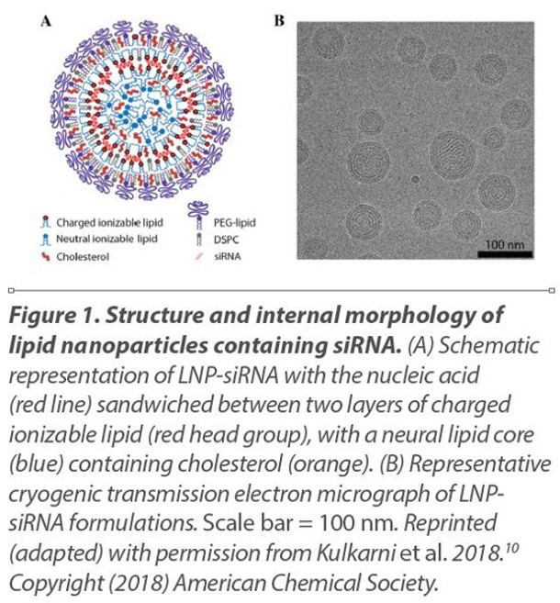
REGULATORY ASSESSMENT OF THE LNPS
Assessed as a novel excipient
excipients enable the drug substance to be applied to the patient in the right form and supports the way and place of action without being active themselves
Used Onpattro (patisiran) as a guide
Requirements
  Toxicological profile
  Repeat dose toxicity
  Pharmacokinetics
  Genotoxicity/teratogenicity

Slide 24
WHAT WAS NOT ASSESSED AS PER WHO 2005 GUIDEANCE?
Elevated clozapine levels and toxic effects after SARS-CoV-2 vaccination
Deborah Thompson, BCPP, PharmD; Clay M. Delorme, RPN; Randall F. White, MD, William G. Honer, MD
No assessment of the long elimination half-life of ionic lipid (25-30 days) in vitro
Drug Interactions not assessed
CARPA (complement-activation-related pseudoallergy) with the PEG component
Secondary pharmacology and pharmacodynamics
Environmental risk assessment/mRNA
Genotoxicity and Carcinogenicity
  As per guidance, no genotoxicity nor carcinogenicity studies were performed. The components of the vaccine (lipids and mRNA) are not expected to have genotoxic potential. This is acceptable to the Committee for Medicinal Products for Human Use (CHMP). EMA/707383, 2020, EPAR p. 56
J Psychiatry Neurosci 2021;46(2)
The role and impact of polyethylene glycol on anaphylactic reactions to COVID-19 nano-vaccines
P. Bigini, M. Gobbi, M. Bonati, A. Clavenna, M. Zucchetti, S. Garattini & G. Pasut
Nature Nanotechnology volume 16, pages1169–1171 (2021)
CARPA can be particularly dangerous as there is amplification of the initial complement activation trigger that transforms the initial drug effect into a massive vicious cycle of abnormal physiological changes that include pulmonary hypertension, systemic hypotension, myocardial hypoxia, and bronchospasm

Slide 25
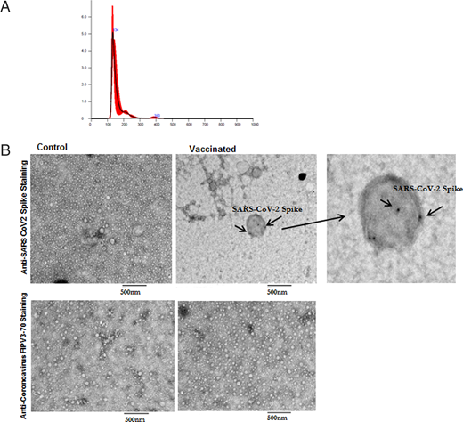
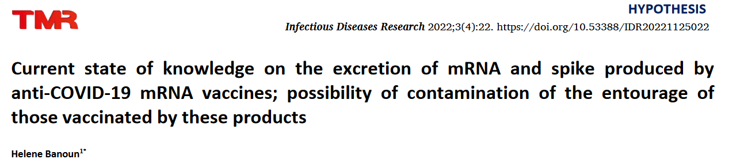
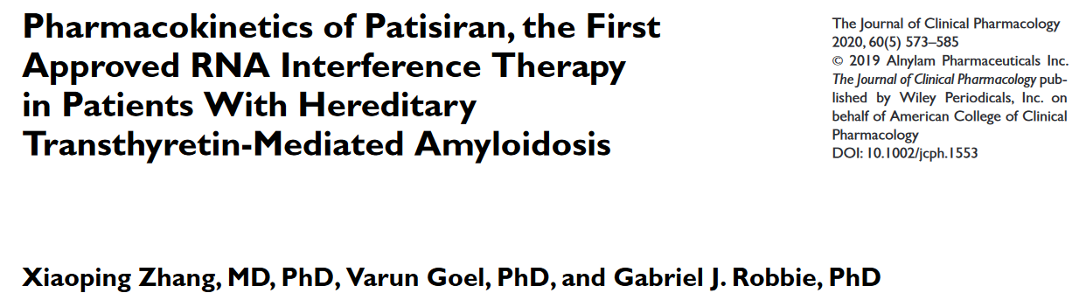
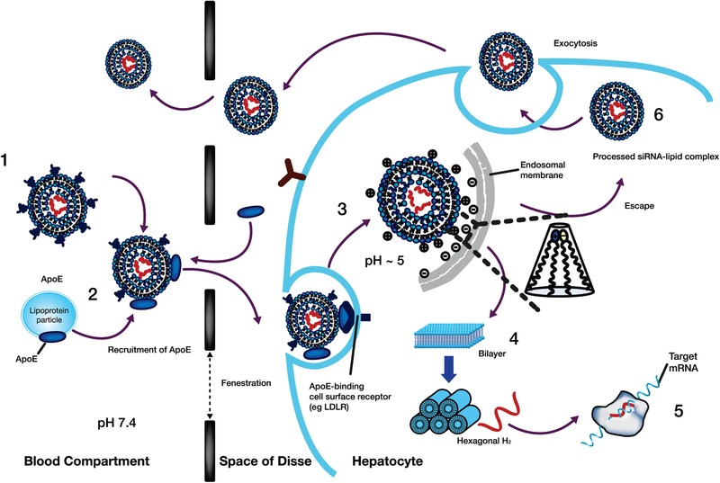
LNP/spike protein elimination
https://journals.aai.org/jimmunol/article/207/10/2405/234284/Cutting-Edge-Circulating-Exosomes-with-COVID-Spike
IS THIS HOW SHEDDING OCCURS?
EMA assumed mRNA and lipids naturally degrade, so no excretion studies performed as per WHO 2005 guidance
  Required if assessed as gene therapy
Bansal et al showed exosomes released by day 14 after vaccination even before spike antibodies are formed
Increased after 2nd dose; sizes were similar to LNPs
Consistent with data from patisaran (Onpattro) where siRNA is egressed with lipids in exosomes
  Half-life of 60-80 days
Extracellular vesicles able to transfect
  Less cytokine stimulation compared to intact LNPs
NEEDS VERIFICATION WITH MRNA VACCINES

Slide 26
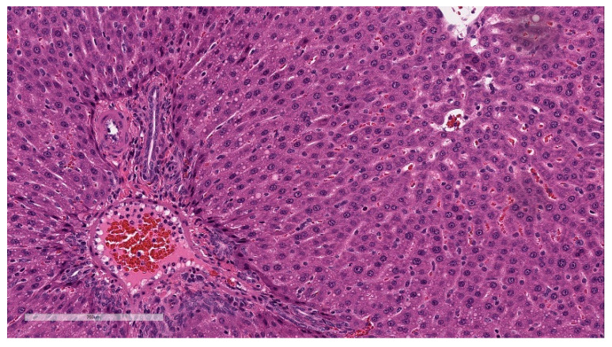
Toxicity Assessment in Rats
Only whole formulation used
Variety of modRNA formulations studied
STRONG HEMATOLOGICAL RESPONSES
  Difficult to interpret; no dose response design
Liver effects including periportal vacuolations, increased liver enzymes
Toxicity of nanoparticles
  surface area to mass ratio increases as the size of particulates decreases, and the toxicity of particulates often, but not always, correlates with surface area more than mass (Hubbs et al. Toxicological Pathology 2011;39;301-324)
…no further experimental toxicological studies are considered necessary as the use of the whole formulation (RNA + LNP) in the repeat-dose toxicity and DART studies is sufficient to qualify the novel excipient lipids in combination that the overall effects are also being assessed in the clinical trials.
  Rapporteur’s Rolling Review assessment report: Overview and list of questions. EMEA/H/C/005735/RR.10
https://www.ncbi.nlm.nih.gov/pmc/articles/PMC9965811/

Slide 27
Are LNPs adjuvants?
a vaccine antigen augments or potentiate and possibly targets the specific immune response to an antigen (FDA Regulations)
…the LNP can activate the innate immune system of mice, by the synthesis of pro-inflammatory cytokines. As the effect was transient, this effect could be considered as an adjuvant-like effect. Overall, based on above, the LNP formulation is expected to have not only a role to protect modRNA from nucleases degradation, and facilitating cellular transfection, but also adjuvant like effects. Rapporteur’s Rolling Review assessment report: Overview and list of questions. EMEA/H/C/005735/RR 2020
EMA guidelines for an adjuvant (https://www.ema.europa.eu/en/documents/scientific-guideline/guideline-adjuvants-vaccines-human-use-see-also-explanatory-note_en.pdf)
  CMC
  Repeat dose toxicology, systemic toxicology
  Local tolerance, allergic reactions
  Genito- and carcinogenicity

Slide 28

BIODISTRIBUTION
Traditional pharmacokinetic studies not done and are generally unhelpful
Dependent on route of administration
In vivo distribution of luciferase of various LNP formulations in mice
  Non-validated method
  peak level 6 hours post injection and slowly decreased during the first 72 hours and then again after 6 and 9 days
In vivo distribution in rats with radiolabeled LNP formulation in DP
  Luciferase, not modRNA
  Sequence of mRNA could affect signal persistence and/or stability
  48 hrs only; should continue until no signal detected
  No tracking of lipids, metabolites or spike protein
  Redistribution to ovaries, bone marrow, thyroid, others at end of reporting period
No Specific Obligations imposed which may indicated no further studies needed for future mRNA vaccine

Slide 30
Assays and limits or critical quality attributes (CQA)
“In-house” assays by BioNTech/Pfizer
Needed external validation; how to measure purity?
What are the appropriate limits for contaminants?
  dsDNA, dsRNA, endotoxin, potency, LNP contaminants
No compendial standards available
  USP-NF Draft compendial standards only currently proposed
  Many assays/tests are proprietary
Contaminants
  “Late migrating species” only picked up with more sensitive assays

Slide 31

An EMA Reviewer Final Poignant Observations
an inherent variability in the production process,
inherent difficulties foreseen with testing methodology
a novel manufacturing or control technology
the potential presence of toxic impurities
and a particular risk of bioavailability problems

Slide 32
WHO 2005 GUIDELINES WHOLLY INADEQUATE
Drug substance
  Codon optimization
  Contamination
  Duration of modRNA
  Characterization and potency
LNPs
  Manufacturing, formulation, stability
  Exosomes
  Toxicity
  Biodistribution
  Pharmacology, CARPA, DI, etc
    Adjuvant vs excipient vs new molecular entity
Assays and CQA limits
NEW WHO 2022 Guidelines for mRNA vaccines; NEW FDA Guidelines

Slide 33
Evaluation of the quality, safety and efficacy of messenger RNA vaccines for the prevention of infectious diseases: regulatory considerations. WHO 2022 (WHO TRS, No. 1039).
“if expression of truncated or alternative forms of the target antigen is demonstrated during characterization studies and these alternative forms would result in neo-antigens or unwanted immune responses, then this may require a redesign of the mRNA sequence” pg115
“Potency specifications for the mRNA vaccines should be set based on the minimum dose used to determine efficacy …Upper limits should also be defined based on available human safety data.” ….. “Manufacturers are encouraged to work towards the goal of employing in vitro assays that are suitably quantitative and assess function.”
“…detailed analytical procedures and acceptance criteria for tested attributes are not yet in the public domain and may be considered proprietary and confidential..”

Slide 34

NEW PLATFORM AND NEW CONCEPTS
MODIFIED MRNA PRO-DRUG
TRANSFECTION
NANOPARTICLES

Slide 35
https://amidwesterndoctor.substack.com/p/we-now-have-definitive-proof-pfizer

